Slide 1

Fall Forum 2012

Slide 2

Introductions
Nasr Abdo, Fulbright Language Teaching Asst.
Jeffrey Barnes, Adjunct, LS/Library
Richard Benninger, Visiting Ag. & Food Mgt.
Annie Breglia, Keyboard Spec. 1, Admissions
William Brownell, Asst. Complex Coord.
Steven Calabrese, ISA College Farm
Dwayne Childers, Senior Banner Programmer
Christopher Diaz, Cleaner
Holly Ellram, Visiting, Nat. Sci. & Math

Slide 3

Introductions
S. Scott Ferguson, Visiting, Business & IT
Peter Fitzgerald, Site Representative
Jaimie Handy, ISA Ag. & Food Mgt.
Douglas MacLeod, Visiting, Liberal Studies
Matthew Mahoney, Computer Technician
Brian Marhaver, CAS Director
Cheryl Perog, Nurse Practitioner
Heather Procopio, Athletic Trainer
Audrey Rapant, Adjunct, Ag. & Food Mgt.
Jill Reid, webmaster (shared with Delhi)

Slide 4
Introductions
Christine Richter, Adjunct, Ag. & Food Mkt.
Mohamed Saeed-Baligh, Electronic Media Counselor/New Media
Laura Skinner, IST Nat. Sci. & Math
Steven Spinicchia, UP Officer 1
Alysha Stephens, Merits Coordinator
Kimberly Sternheimer, Adjunct, Ag. & Food

Slide 5
Introductions
Lauren Warner, Adjunct, Liberal Studies
Jaymes White, Residence Hall Director
Trudy Williams, Writing Center Manager
Kelly Yacobucci, 1st Year Exp. Counselor
Anthony Young, Adjunct, Ag. & Food Mkt.
Hui Zhao, Research Asst., Biotechnology

Slide 6

Promotions/Position Changes
Derwin Bennett to Director of EOP
Mark Braun to Professor
Howard Coger to Carpenter
Paul Dunn to EOP Acad. Advisement Asst.
Dayton Maxwell to Professor
Kathleen Miller to Plant Utilities Asst.
Deborah Richards to Staff Associate
Donald Schaffer to Plant Utilities Eng. 3
Kane Seamon to Crops & Equip. Mgr.
Joseph Sprague to Distinguished Teaching Professor
Christopher Stanonis to Complex Coordinator
Jennifer Walrath to EOP

Slide 7
Retirements
Francine Apollo
Robert Barringer
Joe Brown
Shirley Lawyer
Pat Lepore-Moody

Slide 8

Sabbaticals
Gail Wentworth – spring or fall 2013
Returning:
Pamela Collins
Melody Eldred
Chuck Moran
Cynthia Shelley

Slide 9
New Assignments
Irene Loucks to School of Bus & LAS
Michael McCaskey to Ag. Engineering
Jonathan Morrell to International Edu.
Amanda Reinhart to Financial Aid
Michael Wacksman to Student Life
EOP program relocated to Library, closer to academic support services
Research Found. staff to Warner & Ryder
Creating Healthy Places grant coord.to Ryder

Slide 10

Shared Services with Delhi
Jill Reid, Webmaster
New Culinary faculty, Sean Pehrsson
Shared services report posted
Search for shared IT Procurement Specialist underway

Slide 11
2011-2012 Priorities
Middle States
Campus Appearance
Enrollment

Slide 12

Middle States Update
Standard 7 passed, monitoring report required in 2013
Ongoing preparation for 5-yr. periodic review report (2016) which must address:
  23 recommendations from 2011 visiting team
  Major challenges and opportunities
  Enrollment and financial data for period covered by strategic plan
  Assessment of institutional effectiveness and student learning
  Use of data to improve programs and services, inform planning and allocate resources
  Linkage of institutional planning and budgeting processes

Slide 13
2012-2013 College Goals
Student Success – Retention & Graduation
Implement Academic Prioritization Plan
Initiate Administrative Prioritization

Slide 14

Student Success
Increase student retention
Increase graduation rate
Continuous improvement of all campus services
Continued emphasis on campus appearance

Slide 15

Academic Prioritization Plan
Academic Prioritization Task Force completed work and made recommendations
Faculty met and accepted recommendations
Establishing plan for implementation

Slide 16
Administrative Prioritization
Administrative Council to provide leadership
Year long process
Goals:
  Improve service
  Realign resources

Slide 17

Academics
Internship application & assessment processes updated & implemented
SUNY/SED approved Applied Psychology program, students begin fall 2012
Office of Prof. & Cont. Ed. completed 1st year:
  SUNY/SED approved Paramedic certificate & weekend format for BBA in Business Administration & Financial Services
  Early Childhood degree completion program begins fall 2012 at Jefferson Community College
Paramedic reaccredited; Histotechnology completed accreditation visit with positive outcome anticipated
1st online Teaching Academy for faculty summer 2012
Academic Administration modified to support interdisciplinarity and to redirect resources to instruction

Slide 18

Academics Continued
Academic Council re-established & provided feedback on 5-year program reviews
17 faculty publications in 2011-12
52 state & national presentations by faculty/staff in 2011-12
32 faculty/staff serving in leadership roles in state & national professional organizations during 2011-12

Slide 19

Academics Continued
Professional Development Update
  126 requests funded; $162,159 awarded in 2011-12
  Application (www.cobleskill.edu/professional-development)
Academic Services Update
  New Office of Admissions practices implemented
    1st electronic communications campaign using Fire Engine Red (FER) Client Relations Management (CRM)
    Accepted student Facebook group
    Cobleskill applications for tablets and smart phones
    “CobyBound” web page to prepare new students

Slide 20

Enrollment
+4% in apps, +3.5% in deposits fall
+7% out-of-state
30 int’l students: Egypt, Oman, Japan, China, UK, Nepal, Brazil, Cambodia, Vietnam, Turkey
+1.5%-2% increase heads fall
42% of total heads: bachelor degree seeking
+10% housing requests for new students

Slide 21
Business & Finance
Exceeded 2011-12 tuition revenue target, $260k to IFR cash reserves of $6m
Funded $500k in equip/furniture 2011-12
  $200k academic areas
  $75k student service depts.
  $78k – 3 fleet vehicles including flex fuel car
  $100k much needed facilities equip.
Worked with FASP to revise operating budget requests to align with SP; continuing to refine
Ranked 7th (out of 34) campuses achieving MWBE target of 14% (13.64%). Target increasing to 20% for 2012-13

Slide 22
Business & Finance Continued
Online electronic student billing/payment-spring 2013
Increased tuition rates:
  NYS resident +$300/yr. = $ 5,570
  Non-resident +$500/yr. = $14,820
Required to fund “TAP Gap” ($300k)
2012-13 state support remains unchanged – will need
$2m of campus reserves to cover operating shortfall
Submitted request for academic mission funding adjustment (School of Ag. & Nat. Res.) as part of SUNY’s new resource allocation model for 2013-14

Slide 23

Business & Finance Continued
Cabinet approved many strategic & new initiatives submitted with 2012-13 budget requests funded through campus reserves :
  $350k (max) equipment & furniture replacement including motor pool replacement cycle
  Campus beautification – Prentice Hall Terrace
  Signage & display flags
  Knapp entrance
  Cultural competence programming

Slide 24
Strategic & New Initiatives cont.
  Document imaging (Nolij upgrade or Banner)
  Academics
    Art & display cases for library
    Culinary equipment
    Speakers & guest lecturers
    Champlin storage closet
    Art gallery

Slide 25

Student Life
“Late Night Coby” – weekend late night hours, facilities access, > programming in Bouck
6 construction firms finalists to build 156 bed student apartment complex (start spring 2013)
Created Center for Community Engagement (expansion -Office of Communiversity Affairs)
Emergency Broadcast System live Fall 2012
Matt LaLonde new leader for Veteran Affairs

Slide 26

CAS
Barnes & Noble contracted to manage bookstore
Enhanced Coby’s - new menu, hours, tables, partnering with Culinary – dinners Thurs-Fri.
Refresh Prentice Phase II – 2 chef stations
Refresh Champlin – major renovation of each of 3 dining rooms, new flooring, lighting, tables, etc.
Upgraded Warner Café
Late night dining relocated to Twisted Whiskers

Slide 27

Athletics
NCAA DIII – full acceptance, eligible for post season competition
Kevin McCarthy, Vice Chair, NEAC Board of Athletic Directors Executive Committee
3 Fighting Tigers earned SUNY Chancellor’s Athletic Scholar Award
24 student athletes named to NEAC Scholar Athlete Honor Roll
Outdoor Fitness Trail rehab/upgrade
Fitness Center upgrade
1st annual Athletic Booster Club Golf Tournament 9/28

Slide 28

Residence Life Renovation Projects
Completed Parsons bathroom project ($1.6m)
Painted Parsons and Davis bathrooms
Carpeted Parsons, Vroman & Wieting
Replaced Wieting doors
Replaced window caulking Fake & Ten Eyck
Installed card access for 2 add’l ext. doors
Cleared roofs of debris
Preventative maintenance

Slide 29
College Relations, Communications & Marketing
Director’s search underway
  Scott Silversten to Florida Atlantic University
  Bonnie Martin chair
Interim PR needs :
  smithjm@cobleskill.edu; 255-5731
Admissions Publications & Support
  New view book & travel piece at printer
  Support materials in design
  Updated academic program brochures in progress
  Academic program sheets on hold until new Director hired

Slide 30

College Relations Continued
Updated Communications Guide – online
Graphic Standards Guide nearly complete
New format for business cards
Coby Now – Convenient!
  Meetings, announcements, news on your desktop daily
  Send items to: mediarelations@cobleskill.edu

Slide 31

College Relations Continued
Web – Jill Reid, shared Webmaster, win-win
  Monthly evaluation of web site hits & engagement
  Added rotating image slideshows to each landing page
  New sections for Summer Session, Community Engagement, Graduate School Info, Construction Updates
  Developed new web forms
  Looking Ahead
    Finalizing mission statement with Web Adv. Comm.
    Slight redesign of homepage & addition of interactive enhancements, including videos
    Design new community page
    Research & test campus-wide calendar system

Slide 32
College Advancement-Annual Fund
  Despite flood 1,400 pledges @ $63,961
  Highest pledge fulfillment to date @ 67%
  Highest parent pledge fulfillment to date @ 56%
  Success due to 1,427 student payroll hours calling 26,000+ to alumni and parents
  First affinity-based (alumni paired with campus interests) calling spring 2012. Ag. Eng. Faculty Scholarship yielded 89% (highest) fulfillment rate, past alumni awardees called for Title III Prof. Dev. next highest rate
  Title III started in 2008-09 with goal of $330,391 raised to be matched by DOE. Raised $261,340. Think Title III for your Annual Fund gift this year!
  Faculty/Staff Annual Fund giving DOUBLED to $35,274!

Slide 33

College Advancement - Foundation
Annual Fund Event sponsored by the Foundation
  Culinary Extravaganza – netted four times as much as the 2011 Dinner Dance for a total of $10,117.80 and 220 guests
  26th Annual Foundation Golf Tournament – 132 golfers, netted record results of $17,000 thanks to the support of our local and regional corporate partners, alumni and faculty and staff

Slide 34
College Advancement - Foundation
Natural Disaster Fund balance $27,000
Congrats to Dr. Tom Cronin, elected as Faculty Representative to the Foundation Board

Slide 35

College Advancement - Foundation
“Moving the Rolling Hills into the 21st century”
$5m fundraising campaign - campus initiatives
Enhancement of endowment funds $2.5m
  Robert Emmons Endowed Chair
  Jack Ingels Endowed Professorship
  Dr. Michael Murphy Endowed Professorship
“1911 Heritage Society” - $350,000
Academic Programming Funds - $350,000
College Scholarship Fund - $400,000
Outdoor Sports & Recreation Complex - $1,750m

Slide 36
College Advancement
Foundation & Alumni Scholarships
Special thanks to members of the Scholarship Comm. for their dedicated service in distributing funds on behalf of the Foundation & Alumni Association.
  Incoming freshmen: 53 awards totaling $ 73,300
  Returning students: 60 awards totaling $ 44,500
  Merrill Scholars: 95 awards totaling $187,750
  Total : 208 awards totaling $305,600

Slide 37

College Advancement - Alumni
Alumni Association building new apartment style housing on the north side of campus.
Supporting, with the College Foundation, the Rt. 7 project by purchasing college banners to be displayed on the lamp posts
Re-establishing alumni publication

Slide 38
Advancement – Grants & Sponsored Programs
 | Submitted 2010-11/2011-12 | Awarded 2010-11/2011-12 | Denied 2010-11/2011-12 | Pending 2010-11/2011-12
Number | 3/28 | 3/10 | 0/17 | 0/1
Amount | $1.15m/$18.8m | $1.15m/$625k | 0/$17.9m | 0/$148k
Total 2011-12 Awards: 13 for $1,776,547
Notes:
  Total # submitted & $ requested are both 4-year highs
  Total awarded ($1,776.547) is average for Cobleskill
  Total # awarded (10) is average for Cobleskill

Slide 39
Grants Continued
4 electro-fishing contracts ($64,204) Mark Cornwell
Leading Principal Investigators:
  John Kowal (2)
  Jason Evans (2)
  Doug Goodale (3)
  Susan Jagendorf (3)
  Mike Wacksman (2)
Other grant activities:
  DECMOU renewed for 3 yrs. ($822,000), Mike Losito mgr.
  Drs. Harman (Oneonta) & John Foster – NSF $94,315, equip. in grant utilized on campus in paddlefish diet studies & others

Slide 40

Facilities Management
Capital Projects in Construction
Dairy Complex infrastructure improvements, heifer barn (8/12)
Route 7 enhancement project (8/12)
Campus site surface upgrades – reconstruction of green spaces, plazas, walkways (11/12)
Wheeler Hall interior renovation (9/12)
Emergency broadcast system (8/12)
Center for Ag. & Natural Resources (6/14)
New construction website (projects, updates, detours, etc.): www.cobleskill.edu/construction

Slide 41

Facilities Management
Projects in Design
Alumni Commons (7/14)
UPD Johnson Hall addition (1/13)
Sidewalk construction for safety – North campus (8/13)
Refurbish water tank & upgrade lines (8/13)
Renovation of Home Economics (1/16)

Slide 42
Facilities Management
Capital Crew
4 new, ft, CSEA rep. employees started 6/1
Funded entirely through Capital Plan
Doing small capital projects on campus
Greater responsiveness, saves money
Free maintenance staff to do maint. work
Accomplished so far:
  Refurbished Tiger’s Den
  Modified space to relocate Fisheries/Wildlife & livestock for CANR
  Installed hardware for emergency broadcast system
  Extensive work in the hangar
  Installed acoustical tile in Wheeler addition

Slide 43

Facilities Management
Capital Crew
Planned for this fall:
  Schopeg updates
  American Heritage restaurant updates
  Wheeler addition soundproofing
  Champlin Catering Lab updates
  New Fitness Stations on Fitness Trail
    Grounds Dept. will rehab and replace items on current Fitness Trail
    Installation of 11 new stations

Slide 44

Human Resources
Local retirement incentive offered – 16 faculty and staff retiring
Workplace Violence prevention program and training – entire campus trained
New M/C evaluation process launched
HR administering professional development funds

Slide 45
ITS –Summer Projects Update
Warner Hall data center upgrades – new, fast servers; 20 terabytes of storage
Wireless upgrades to all academic areas – can accommodate multiple Internet devices
Wheeler renovations
Bouck Theatre projector replaced
Warner 11, Wheeler 110, Hodder 105 upgraded
Replaced voicemail systems, can forward messages to email, smart/cell phones
Email upgrade (MS Live to Office 365)

Slide 46

ITS Upcoming for 2012-13
CANR construction
New residence apartments IT planning
Internet upgrade to 1GB bandwidth
Continued Datacenter upgrades
Continued network upgrades
Continued computer lab upgrades
Continued end user equipment upgrades
Continued classroom upgrades

Slide 47

ITS Upcoming Continued
Banner upgrades/improvements – Degree Works, Nelnet, eRezLife, reporting and other as recommended by SWAT Committee
Degree Works going live fall 2012
Web upgrades/improvements as recommended by Web Standards Committee

Slide 48
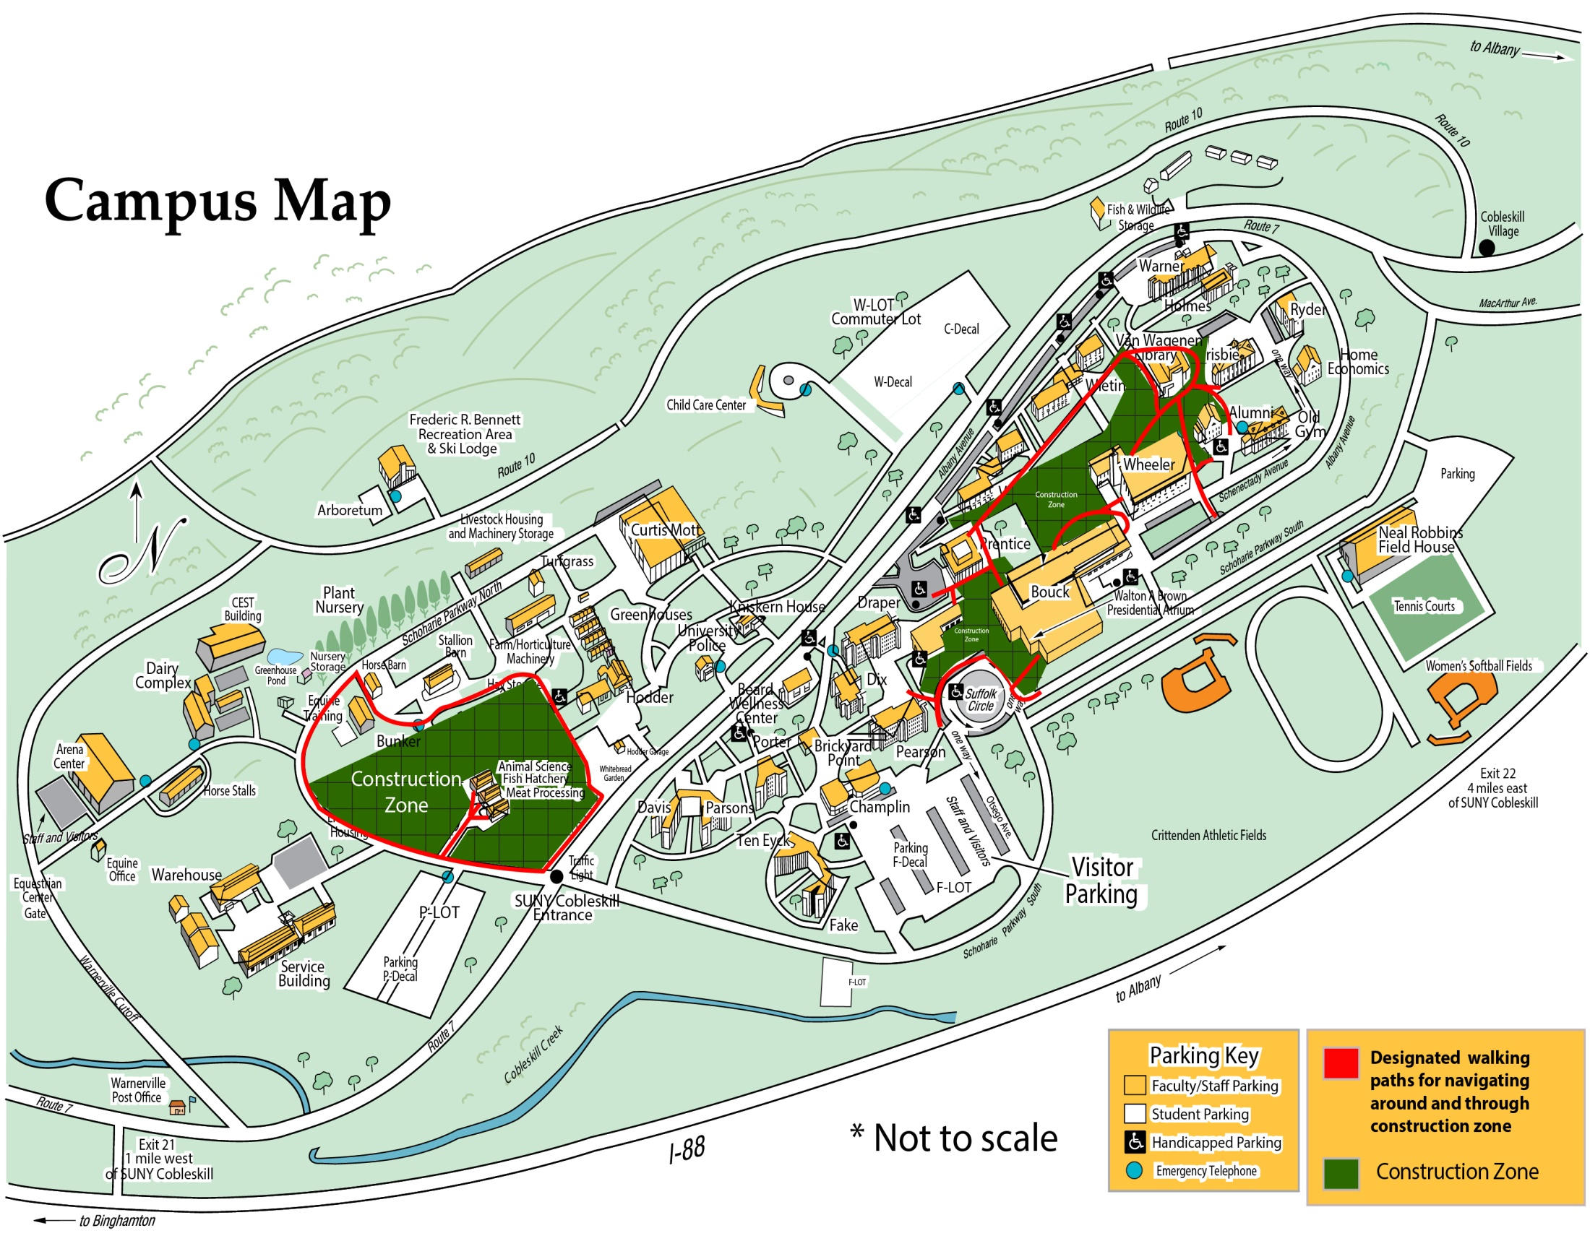

Slide 49
Announcements

