Slide 1
TRAVELING FOR SUNY COBLESKILL

Slide 2
TRAVELING??
Why do you need to travel?
What are your responsibilities?
What forms will you need?
What is the process?
Where may I find more travel guidelines?

Slide 3
What Are My Responsibilities?
Justify the need for Travel
Review and understand the Travel Guidelines
Estimate Travel Expenses
Obtain Approval from Supervisor
Submit a Travel Order in a timely manner
Submit the Request to Exceed Maximum Lodging Rates prior to the trip, if necessary.
Use a Travel Card or NETCard for Expenses
Keep all Receipts
Submit Travel Voucher and all Receipts
Submit Receipts with Credit Card Statements

Slide 4
FORMS TO USE
Travel Order
Hotel Tax Exemption
Travel Voucher
Statement of Automobile Travel
Rental Car Policy
Request to Exceed Max Lodging Rates
All forms and travel policies may be found on the Office of Business Affairs webpage on the Travel page.

Slide 5
ESTIMATE THE COST OF THE TRIP
Conference Fees
Transportation
Lodging
Meals
Incidentals
Please note: SUNY Cobleskill does not issue Cash Advances to Travelers.

Slide 6
Travel Order
Travel Orders must include the traveler(s) name, destination, charge account, date/times of departure and return, purpose, reason for traveling, estimated travel expenses, and must be signed by the budget holder.
Travel Orders must be completed and sent to the Business Office for all state funded travel.
The Business Office will forward Travel Orders to Facilities so the traveler may reserve their vehicle through the Vehicle Reservation System.

Slide 7
Official Work Station
A traveler is considered to be in Travel Status AND Eligible for reimbursement of lodging, meals, transportation, and miscellaneous travel expenses when their destination is more than 35 miles from BOTH their official work station and their home.

Slide 8
Conference Fees
Conference Fees may be charged to a Travel Card or a Procurement Card
Confirmation of the charge must be retained and submitted with the credit card statement.
If charging to a personal card, reimbursement will be completed after the trip has been completed.

Slide 9
Transportation
Fleet vehicles must be used for all state travel, if available.
Drivers must be 18, and must meet the requirements of the License Event Notification System (LENS).
Fleet reservations may be requested through the Vehicle Reservations system on Sharepoint.
Personal vehicles may only be used when a Fleet Vehicle is unavailable, or a rental is not feasible, or when the traveler is not seeking reimbursement for mileage or fuel.

Slide 10
LODGING
Castle Howard, Yorkshire, UK

Slide 11
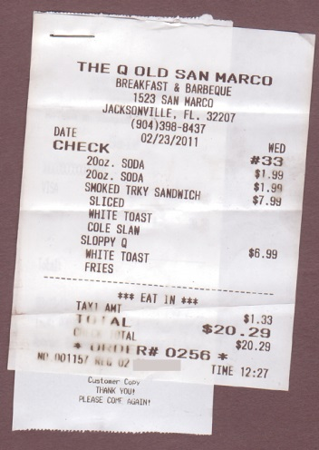
Lodging and Meal Per Diems
Two Methods for Reimbursement
1. Unreceipted Method (Method 1)
2. Receipted Method (Method 2)

Slide 12
Unreceipted Method (Method 1)
Method 1 - Provides a daily flat rate allowance for meals, lodging and incidental expenses regardless of where lodging is obtained.
New York City and Nassau, Suffolk, Rockland and Westchester Counties $50
Cities of Albany, Binghamton, Buffalo, Rochester, Syracuse and their respective surrounding metropolitan Areas $40
All other locations in New York State $35
Out of State (this includes any out of state tax) $50

Slide 13
Receipted Method (Method 2)
Method 2 – Provides reimbursement for actual lodging AND an allowance for meals based on federal reimbursement rates for the county of lodging.
Itemized Receipts are REQUIRED for lodging but not for meals.
Travelers are eligible for the maximum per diems for each day they are in overnight travel status (Includes dinner the first night and breakfast the next day.)
Travelers may be eligible for an additional breakfast and/or dinner depending on when required to leave and when they return.

Slide 14
Lodging Sales Tax
All NYS Lodging is NYS Sales Tax Exempt!
Travelers must provide a NYS Tax and Finance Exemption Certification, ST-129 when checking in to a hotel.
It is the Travelers responsibility to ensure that sales tax is not charged. The Traveler must seek a sales tax adjustment/refund if tax was charged.
The Traveler will be personally liable for sales tax charged , and will not be reimbursed for sales tax, and may be required to reimburse the campus for sales tax.

Slide 15
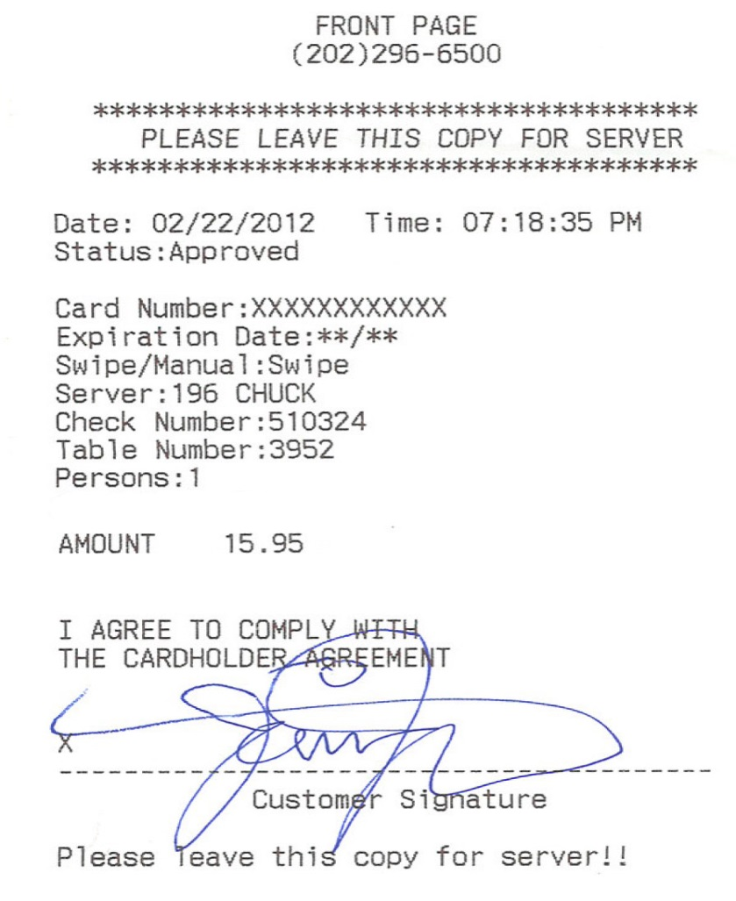
Receipts – MUST be Itemized
Both of these are examples of unacceptable receipts. The invoice on the left is not itemized. The invoice on the right includes Alcohol.
ALCOHOL MAY NOT BE PURCHASED!!!

Slide 16
Acceptable Receipt
This is an acceptable invoice. This receipt is itemized, does not include alcohol, and tax IS appropriate when charged out of state.

Slide 17
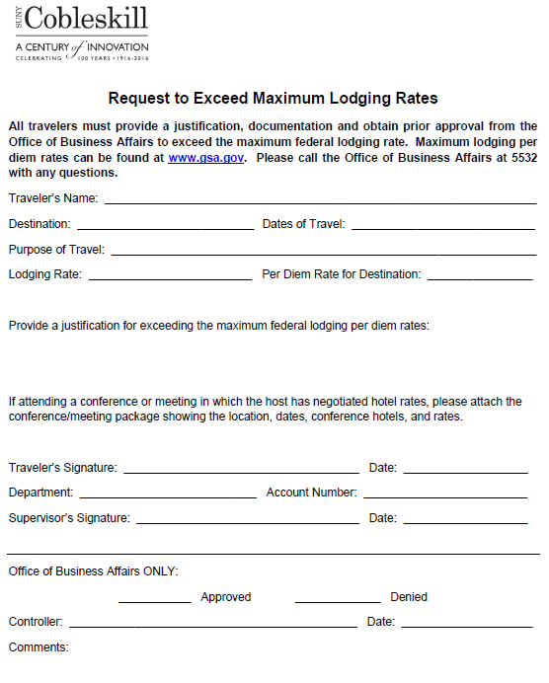
Conference Considerations
Occasionally, travelers must attend conferences sponsored by other organizations at venues which exceed the maximum lodging rate.
Travelers must obtain Prior approval from Business Affairs to exceed the maximum lodging rate.
Justification must accompany the Request to Exceed Maximum Lodging Rates Form.

Slide 18
Other Reimbursable Expenses
Acceptable Reimbursable Items with Receipts include:
Business-related Telephone Calls
Internet Connection Fees
Baggage Transfer and Storage
Parking
Taxi or Shuttle Charges
Tolls
To be considered reimbursable, these expenses must be reasonable, actual AND necessary.

Slide 19
NON-Reimbursable Expenses
Unacceptable items include:
Parking Tickets
Speeding Tickets
Laundry Service
Valet Service
Seat Upgrades
New York State Taxes
Personal Charges
Fees associated w/Flight or Train changes for personal reasons
Personal Travel passports and travel VISAs

Slide 21
Travel Cards
Travel Cards (T-Card and NETCard) are issued to the individual traveler.
Each traveler is responsible for the charges on their T-Card or NETCard.
Charges for other travelers MAY NOT be charged on the travelers T-Card. NETCards are the exception (IE. Team Travel)
Travelers may use their cards to purchase their meals. Meals MAY NOT exceed the per diem rate, and travelers will not receive reimbursement for the difference between the meal per diem and the cost of meal charged to the T-card.
Travelers MAY NOT use their card(s) for CAS, Research Foundation, Cobleskill Foundation, Alumni Association, Student Government and/or Booster Club.

Slide 22
Day Trip Reimbursements
Travelers may be reimbursed for breakfast and/or dinner for day trips based on departure and return times. (One hour before normal work time, and two hours later the normal work ending time.
Breakfast reimbursement - $5.00
Dinner reimbursement - $12.00
Please Note: Day Trip Reimbursements ARE reportable as income to the IRS.

Slide 23
Travel Vouchers
Travelers must complete a Travel Voucher when seeking reimbursement as a result of work-related travel.
All receipts must be attached to the Travel Voucher. (Employee Report of Travel Expenses and Claim for Payment, AC132)
Travelers may not be reimbursed for any travel expenses prior to their departure date, and may not be reimbursed for lodging rates that exceed the maximum per diem rate.

Slide 24
Travel Voucher - Continued
If a traveler used both a travel card, and seeks reimbursement for expenses, the traveler must copy the receipts.
Travel Vouchers should be completed and provided to the Office of Business Affairs within two weeks after the trip has ended to ensure a timely reimbursement.
Reimbursements are no longer provided on a separate check. Reimbursements will be completed through a direct deposit to the account on file with Payroll.

Slide 25
Office of Business Affairs
The Office of Business Affairs Travel web page contains the official guidelines for all state funded travel.
The travel guidelines for SUNY Cobleskill are available on the Travel Page at this link:
http://www.cobleskill.edu/about/administrative-offices/business-affairs/travel.asp

Slide 26
Office of Business Affairs
QUESTIONS???
Please contact us between the hours of 8 AM and 4:15 PM with any questions.
Thank you!

