Slide 1
Violence & Harassment Prevention Training
State University of New York at Cobleskill

Slide 2
Workplace Violence

Slide 3
The College will not tolerate any act or threat of violence made in the workplace, on College property, or while in work status.

Slide 4
Prohibited Conduct includes but is not limited to:
Use of force with intent to cause harm, e.g. physical attacks, hitting, fighting, pushing, or throwing objects;
Behavior that diminishes the dignity of others through sexual, racial, religious or ethnic harassment;
Acts or threats (verbal or physical) which are intended to intimidate, harass, threaten, bully, coerce, or cause fear of harm whether directly or indirectly;
Use of gestures, words, symbols or pictures that communicate a direct or indirect threat of harm;
Stalking an employee with the intent of causing fear to his or her physical safety and health
Carrying, possession or use of any dangerous weapon on College property or in College buildings or facilities.

Slide 5
What puts YOU at risk?
Contact with the public
Working late at night or during early morning hours
Lack of readily available and operational communication devices or alarm systems to obtain assistance
Poorly lighted parking areas, roads, sidewalks, and assembly points
Money transactions, especially those involving cash
Uncontrolled access to the workplace
Prevalence of handguns and other weapons among the public, employees, or students
Lack of training in recognizing and managing escalating hostile and aggressive behaviors
Behavioral indicators – verbal, non-verbal and emotional indicators
Previous security problems that have not been properly addressed

Slide 6
Risk Factors (cont'd)
Complacency
  "It can't happen here"
  "If something bad happens, someone else will know how to react"
  "We don't have the time or money to deal with this now"
Incidents aren't reported because:
  Excuses are made for the individual's violent behavior
  Unwillingness to get involved
  Concern that complaints won't be taken seriously
  Fear of retaliation

Slide 7
Campus Venues with
Higher Than Average Risk
Venues | Examples
Areas Where Money is Exchanged | Champlin and Prentice Dining Centers, Other Food-Service Venues, Campus Bookstore, Student Accounts
Administrative Offices | Business Office, Human Resources , College Association, Student Affairs, College President, Provost Office
Work Sites Where Employees Work Late at Night or Early Morning | Faculty Offices, Library, Classrooms, Champlin Dining Center, Bouck Athletic Areas

Slide 8
Some Practical Tips To Stay Safe At Work
Know where building emergency exits are located and be prepared to use them if necessary
Conceal valuables
Keep emergency numbers handy
Be aware – pay attention to surroundings
Walk and present oneself confidently
If working late
  Tell someone where you are
  Be sure your cell phone is available and fully charged
  Keep emergency numbers handy
  Park in a well lit area
  Call University Police 255-5317 for an escort

Slide 9
Examples Of Safety Measures at
SUNY Cobleskill
Campus-wide emergency call system (Blue Lights)
On-campus escort service by University Police
Card access to residence halls and soon to many other campus buildings and offices
Presence of University Police 24/7
Annual safety walk-around by Campus Safety Committee
Maintenance work-order system which prioritizes correction of safety issues
Employee awareness training
The Workplace Violence Prevention Program, reviewed annually. The program includes:
  Risk assessments
  Identification of high risk factors and locations
  Procedures to report incidents and threats
  Informational training program

Slide 10
Recognize Red Flag Behavior:
Signs Of Distress
Sudden significant change in routine
Extreme moodiness, depression, withdrawal, social isolation, lethargy
Disruptive/risk-taking behavior
Confusion or disorientation
Defensiveness or blaming others for mistake
Holding grudges
Alcohol or drug dependence
Increased absences
Excessive activity, talking, or signs of agitation
Red or swollen eyes
Perspiring when work area is not hot

Slide 11
Recognize Red Flag Behavior:
Signs of Distress in the Classroom
Significant changes in behavior such as performance, absences, level of participation, interactions with classmates, dress, personal hygiene
Argumentative, confrontational, antagonistic, or highly disruptive behavior
Falling asleep in class
Unusual or exaggerated emotional responses

Slide 12
Recognize Red Flag Behavior:
Signs of Crisis
Hostility, aggression, violence
Garbled or slurred speech
Loss of contact with reality
Suicidal thoughts with plans or methods
Homicidal thoughts

Slide 13
Recognize Red Flag Behavior:
Warning Signs of Individuals Prone to Violent Behavior
History of violent behavior
Makes others feel threatened or uneasy
Frequently argumentative, uncooperative, abusive or easily angered
Poor social skills or social relationships
Feels paranoid, victimized, unfairly treated without reasonable cause
Have irrational beliefs or ideas
Behaves in bizarre ways
Is under significant stress
Is suffering from debilitating levels of depression or anxiety
Has problems with alcohol or drug abuse
Exhibits fascination with weapons, brings weapons into the workplace

Slide 14
Recognize Red Flag Behavior:
Warning Signs of a Violent Incident
Person looks flushed or pale
Is perspiring
Appears restless, agitated, shaking
Looks physically very tense
Talks much louder or quieter than necessary
Uses abusive or threatening language
Glares or avoids eye contact
Gets uncomfortably close

Slide 15
Defusing A Threatening Situation
Stay calm – do not raise your voice to match theirs
Empathize – listen to understand and communicate respect
Cooperate – watch your body language
Do not isolate yourself with the person but, if de-escalation seems reasonable, do attempt to remove bystanders
Walk away if the situation continues to escalate
Get Help - University Police ext. 5555 or 911

Slide 16
Reacting to a Violent Situation
If violence is occurring:
Agree to the person's demands other than those involving personal safety
Leave the area – don't be a hero
Employees should NOT attempt physical interventions in workplace altercations. Call University Police, ext. 5555 or 911

Slide 17
Reducing Risks
If threatened, call University Police, ext. 5555 or 911
Seek back-up from a co-worker
Don't wait for a second occurrence. Report concerns to a supervisor, the Campus Safety Committee, Human Resources or University Police
Participate in Workplace Violence educational activities
Practice good active listening skills
Behave in a calm, friendly, and helpful manner
Your personal conduct can help de-escalate conflicts

Slide 18
Workforce Violence Prevention Team
Includes representatives from each union, Director of Human Resources, University Police Chief and Environmental Health & Safety Officer.
Annually conducts a workplace evaluation to identify factors that may place employees at risk of workplace violence, and submits a report of findings through the Safety Committee to the College President
Participates in workplace violence incident review
Annually or after serious incidents, evaluates the effectiveness of the Workplace Violence Prevention Program
All employees are encouraged to participate in the workplace violence prevention program and are encouraged to report any workplace safety concerns to the WCP Team for follow-up.

Slide 19
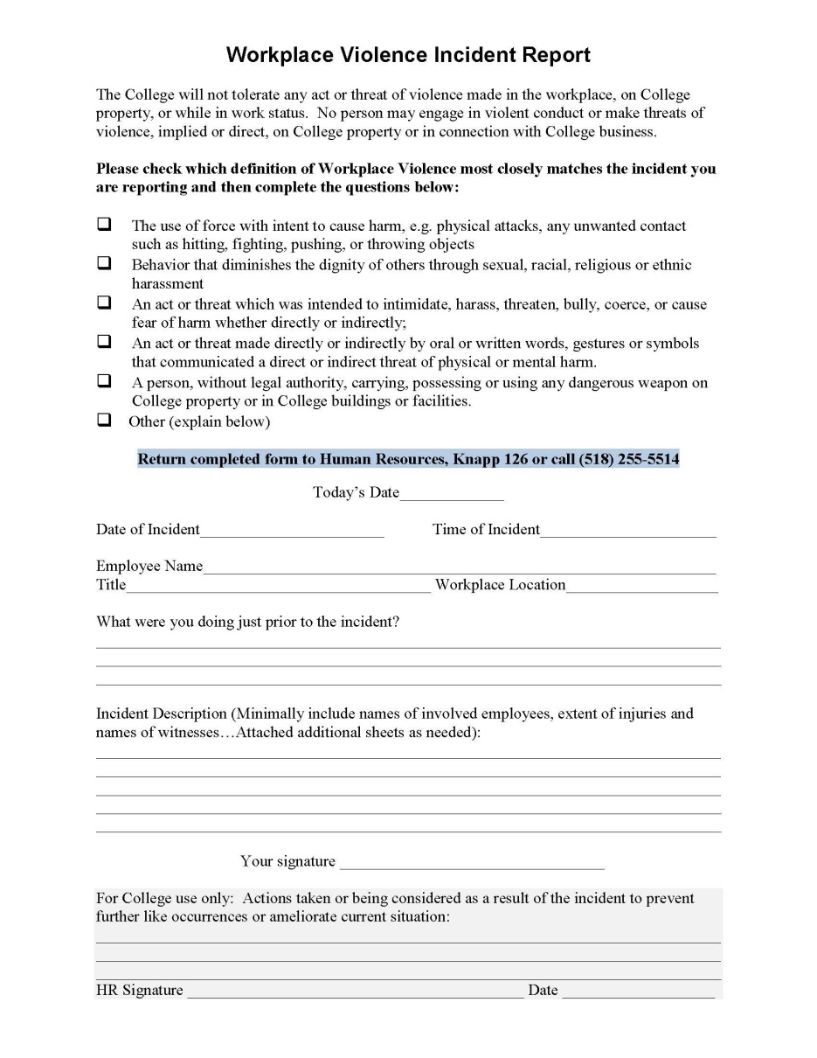
Incident Reporting:
Who, What, Where, When
Report incidents the first time! Don’t wait for a 2nd or 3rd occurrence.
Human Resources is the primary contact for incidents of workplace violence (UPD for physical violence incidents)
Call 255-5423, 255-5514, or complete an Incident Report

Slide 20
Further Sources of Information
A written copy of SUNY Cobleskill's complete Workforce Violence Prevention Program is available upon request from the Human Resources office in Knapp Hall, room 126.
Current NYS laws, regulations, and guidance pertaining to workplace violence prevention: http://www.labor.ny.gov/workerprotection/safetyhealth/workplaceviolence.shtm
Other Resources
University Police: (518) 255-5555
Human Resources: (518) 255-5423, Knapp Hall
Employee Assistance Program: (518) 255-5327
NYS Domestic & Sexual Violence hotlines http://www.opdv.ny.gov/help/dvhotlines.html
NYSBALANCE: http://www.nysbalance.ny.gov/
Post-Incident Crisis Counseling
  Beard Wellness Center: 255-5225
  Employee Assistance Program: 255-5EAP (x5327)

Slide 21
Domestic Violence

Slide 22
Domestic Violence and the Workplace
Recognizing Domestic Violence
Domestic Violence is defined as a pattern of behaviors with the goal of controlling and maintaining power over an intimate partner, including:
  Physical Violence
  Emotional/psychological
  Sexual Violence
  Threats, intimidation, coercion
  Isolation
  Minimizing, denying, blaming
  Using children
  Using cultural or gender-based privilege
  Economic abuse

Slide 23
Domestic Violence and the Workplace: Signs (Cont'd)
Visible physical injuries
Illnesses – especially stress-related ones
Marital or family problems
Alcohol or drug abuse
Poor work performance or employment history
On-the-job harassment by the abuser
Excessive use of telephone for personal use
Disruptive personal visits

Slide 24
Domestic Violence and the Workplace:
How You Can Respond Helpfully
Educate yourself about domestic violence
Question your own attitudes and beliefs about battered women
Learn how to support someone who is the victim of domestic violence
Be prepared to manage your own feelings about the situation

Slide 25
Domestic Violence & the Workplace:
Campus Personnel Policies
The College will take appropriate consideration of domestic violence in all aspects of a victim's work situation, including:
  Requests for leave, FMLA, and absences due to illness
  Appointments
  Promotions or transfers
  Disciplinary cases
  Work site location
  Allocation of responsibilities
  Termination or voluntary separation
  Workplace violence prevention measures
  Confidentiality of employee information
  Access to benefits

Slide 26
Domestic Violence and the Workplace: College Responsibilities
We will actively address any:
  Use of College resources or time to abuse an intimate partner
  Act of domestic violence committed from, or at, the workplace or from any location while on state business
  Use of job-related authority to abuse a victim, to locate a victim or to assist others in perpetrating an act of domestic violence
Help in the Workplace
  Your supervisor, Human Resources, University Police or the Employee Assistance Program can help
  Please provide copies of any Orders of Protection to University Police and/or the Human Resources Dept.

Slide 27
Domestic Violence: Resources
University Police: (518) 255-5555
Human Resources: (518) 255-5423, Knapp Hall 126
Employee Assistance Program: (518) 255-5327
New York State Domestic Violence hotlines http://www.opdv.ny.gov/help/dvhotlines.html
NYSBALANCE: http://www.nysbalance.ny.gov/

Slide 28
Sexual Harassment & Title IX

Slide 29




Title IX Text
Title IX of the Educational Amendments Act of 1972 provides that: “No person in the United States shall, on the basis of sex, be excluded from participation in, be denied the benefits of, or be subjected to discrimination under any educational program or activity receiving federal assistance.”
Notes:
People usually hear about Title IX in the context of college sports, whether it’s sports being added or cut or discussions about how to create proportionality among opportunities for men and women to participate in college athletics.

Slide 30

SUNY Cobleskill Title IX Coordinator
R. Erik Seastedt, HR Director, is the campus Title IX Coordinator. He may be reached at the following:
SUNY Cobleskill
106 Suffolk Circle
Knapp Hall room126
Cobleskill, NY 12043
(518) 255-5514
seastere@cobleskill.edu
Notes:
Title IX Guidance from OCR mandates training for the campus community—employees and students—because education will play a major role in making the campus grievance procedures effective. One key is being able to identify sex discrimination if you see it or experience it. Next you’ll need to know how to report it.

Slide 31
Identifying Sex Discrimination
Title IX prohibits sex discrimination in educational programs and activities
Sex discrimination includes all forms of sexual harassment, including verbal sexual harassment and sexual violence by employees, students, or third parties against employees, students, or third parties
Notes:
Title IX Guidance from OCR mandates training for the campus community—employees and students—because education will play a major role in making the campus grievance procedures effective. One key is being able to identify sex discrimination if you see it or experience it. Next you’ll need to know how to report it.

Slide 32
What is Sexual Violence?
Sexual violence is a form of harassment
Physical sexual acts perpetrated against a person’s will or where a person is incapable of giving consent
Includes conduct commonly known as rape, sexual assault, sexual coercion
Notes:
Sexual violence is the phrase OCR uses throughout the Dear Colleague letter to differentiate between verbal sexual harassment and physical sexual harassment. Sexual violence is a physical form sexual harassment.

Slide 33
What is Sexual Harassment?
Sexual harassment is unwelcome conduct of a sexual nature that is sufficiently severe, persistent or pervasive that it unreasonable interferes with, denies, or limits someone’s ability to participate in or benefit from a program or activity
Examples: Unwelcome sexual advances, requests for sexual favors, and other verbal, nonverbal, or physical conduct of a sexual nature

Slide 34
TYPES OF SEXUAL HARASSMENT
Quid Pro Quo – Latin term meaning “this for that”. The term refers to conditions placed on a person’s career or terms of employment in return for sexual favors.

Slide 35
TYPES OF SEXUAL HARASSMENT
Hostile Environment – occurs when an individual is subjected to offensive, unwanted and unsolicited comments or behaviors of a sexual nature. Classified as hostile if behavior unreasonably interferes with their performance.

Slide 36
Examples of Hostile Environment Sexual Harassment
Nonverbal – May include: Staring at someone (i.e. “undressing someone with one’s eyes”); blowing kisses; winking; or licking of one’s lips in a suggestive manner; displaying sexually oriented pictures or cartoons; using sexually oriented screen savers.
Verbal – May include telling jokes; using sexually explicit profanity or threats; describing sexual encounters with others; suggesting sexual activity; whistling in a sexually suggestive manner; using terms such as “honey”, “babe”, “sweetheart”, “dear”, etc.
Physical Contact – May include touching, patting, pinching, bumping, grabbing, cornering or blocking a passageway, kissing, providing unsolicited back or neck rubs.
Bottom line: If someone thinks you are harassing them, you ARE harassing them!

Slide 37
Who can be harassing?
Supervisors
Coworkers
Students
Vendors
Contractors
Campus visitors
Parents
Etc.
ALL must be reported and will be dealt with, regardless of affiliation with the college!

Slide 38
If you are a witness to, or a victim of an act of harassment or violence or someone reports it to you … REPORT IT!
Human Resources is the primary contact (255-5514)

Slide 39
What will happen when it is reported?
We will explain victim’s options
We will notify of on/off campus resources
We will conduct an investigation
We will maintain confidentiality (not anonymity)
We WILL take action so that it does not happen again
If someone reports to you or if you witness
Tell your supervisor
File a written report
Refer victim to Human Resources or other resources mentioned here

Slide 40
Questions?

Slide 41
Video Resources
Workplace Violence Prevention:
  http://www.cobleskill.edu/about/administrative-offices/human-resources/workplace-violence-video.asp
Sexual Harassment Prevention:
  http://www.cobleskill.edu/about/administrative-offices/human-resources/sexual-harassment.asp
Comprehensive harassment and violence prevention at SUNY Cobleskill:
  www.cobleskill.edu/hr (then click on “Violence and Harassment Prevention tab to the left)

