Slide 1
Air Pollution
By
Alea Morales

Slide 2
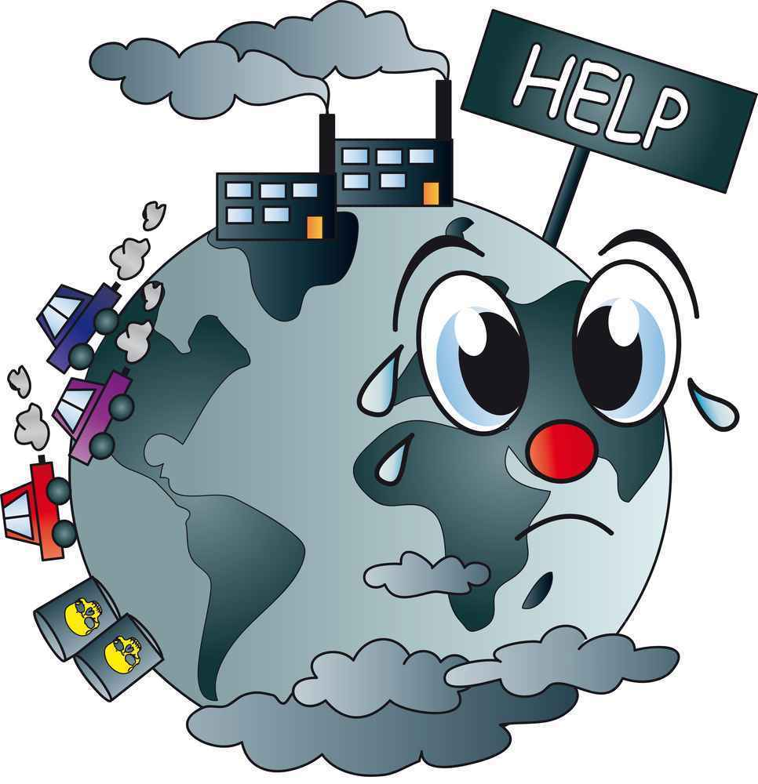
Air Pollution Basics
https://www.youtube.com/watch?v=MoGCU8q7zFo

Slide 3
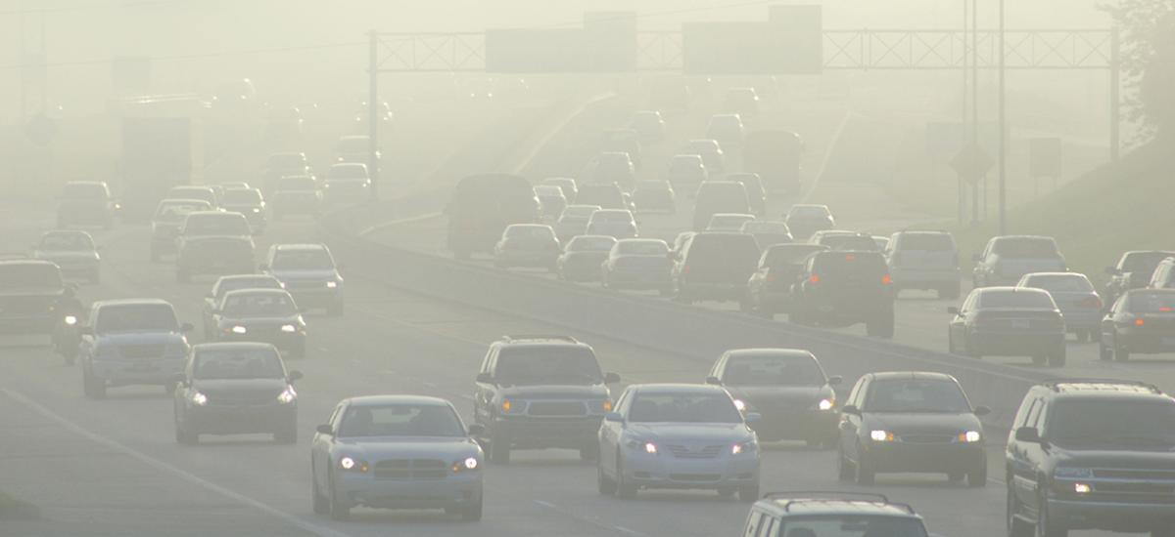
How do cars contribute to global warming?
When fossil fuels like petrol or diesel are burned they give off carbon dioxide - the main climate change gas. The amount of carbon dioxide given off is directly related to the amount of fuel burnt. Heavy cars with big engines use a lot of fuel per distance travelled, releasing more CO2 and worsening climate change.

Slide 4
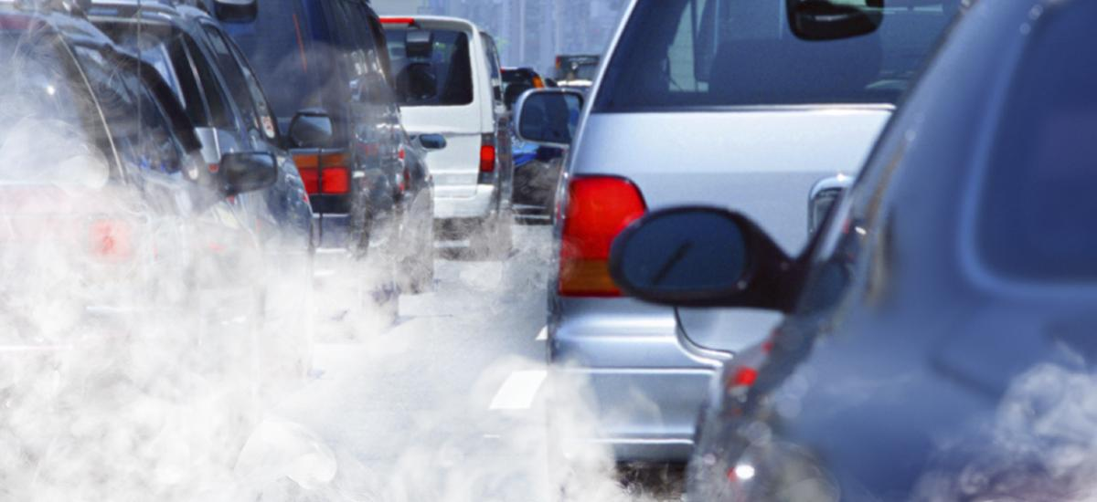
How much do cars contribute to pollution?
75% of carbon monoxide comes from automobiles. In urban areas, harmful automotive emissions are responsible for anywhere between 50 and 90 percent of air pollution.

Slide 5
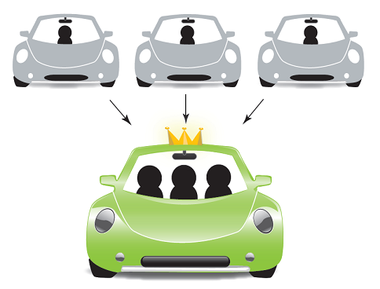


Things that you can do to help
Carpooling
Limit the amount of time in your car
Turning off your car once you have reached the destination
WALKING MORE!!!!!!!

Slide 6
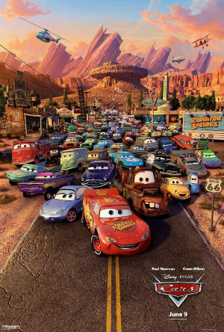
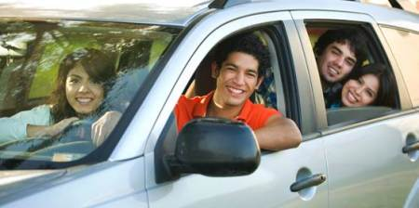
Program Ideas
Taking pics of you carpooling, taking the bus, or even walking to my email and earn a small prize!
Present Power point and watch a screening of the pixar movie “Cars”

