Slide 1
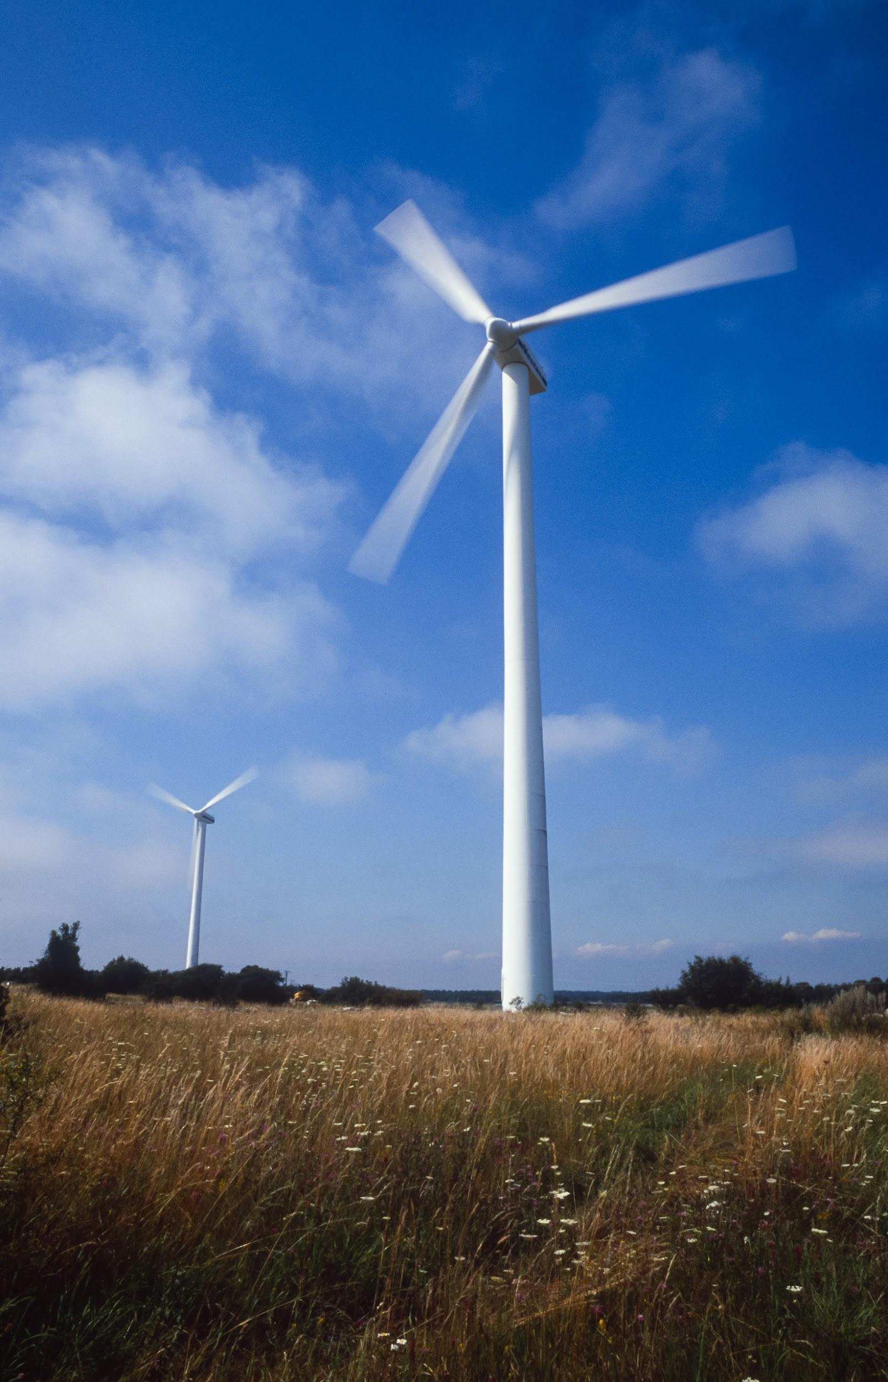
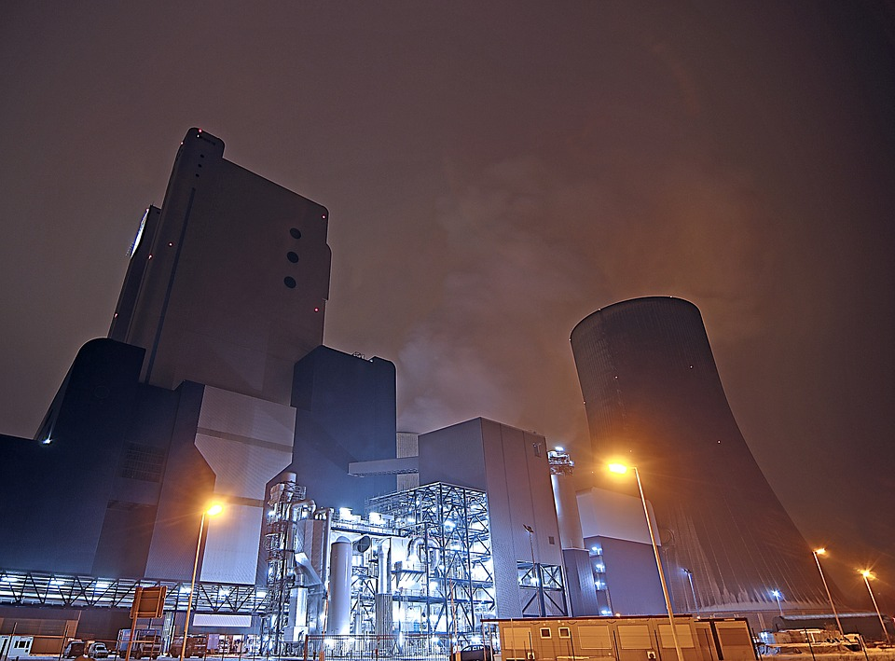
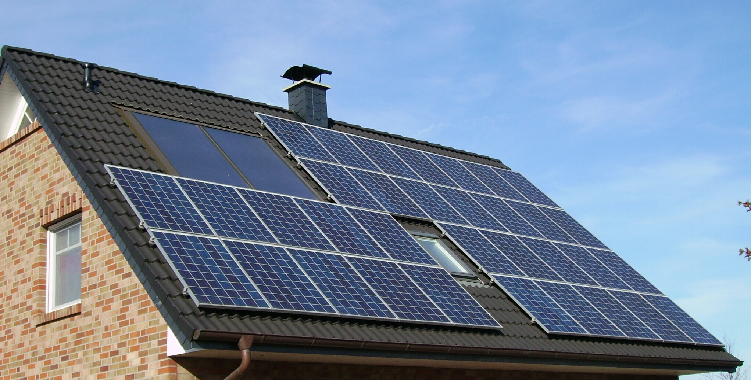
Alternative Power
By ECO Stone

Slide 2
Where We Get Energy From Currently
From the 2015 US energy information administration research
67% of energy comes from Fossil Fuel such as coal, natural gas and petroleum.
20% is Nuclear energy
Only 13% is renewable energy

Slide 3
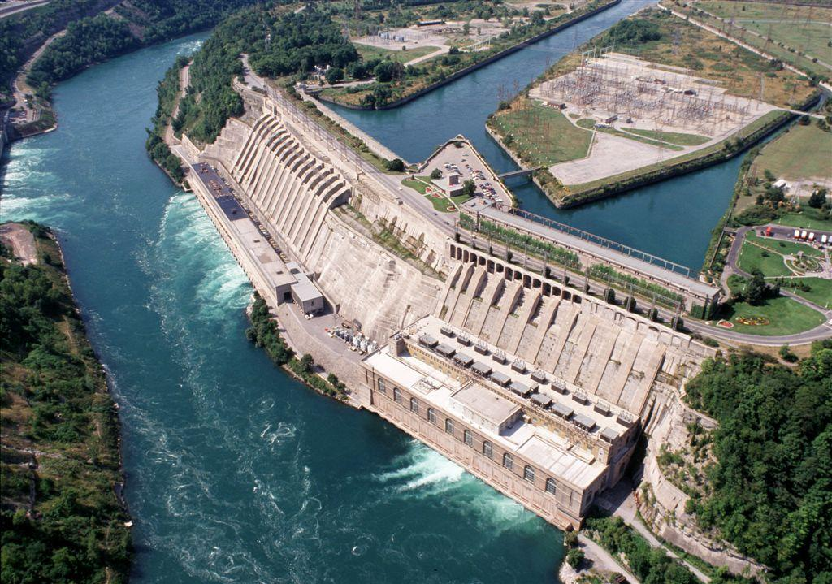
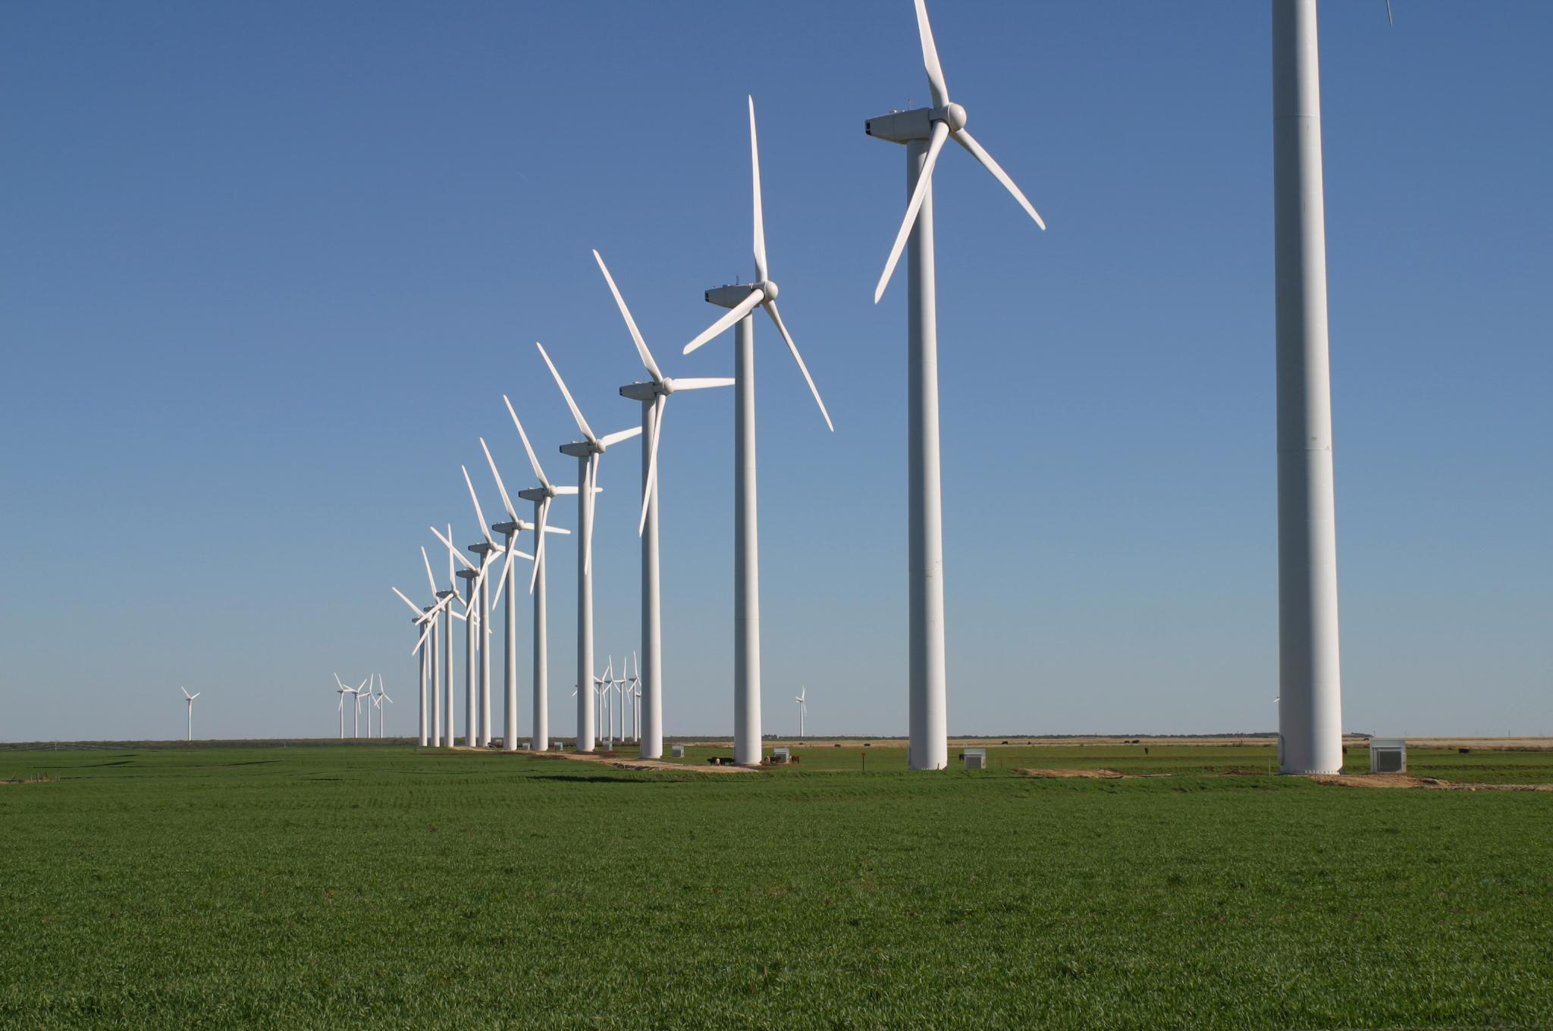
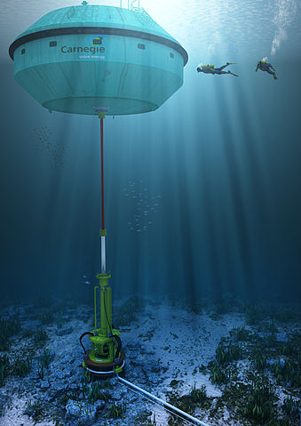
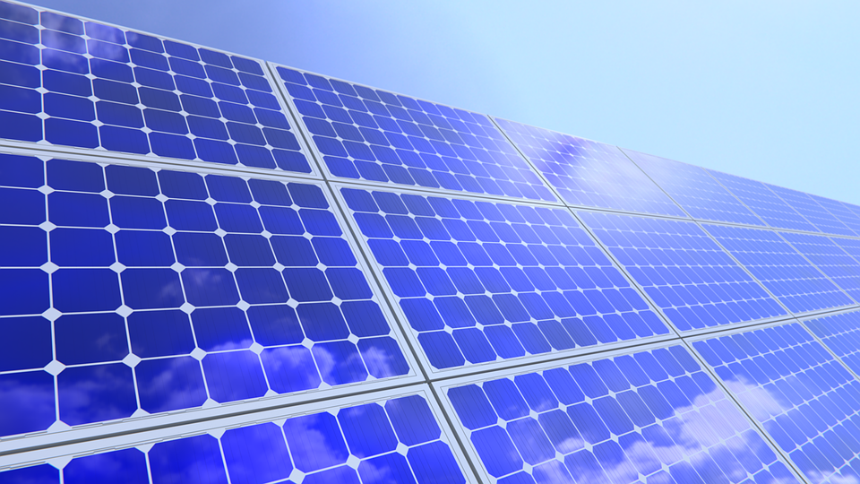
Renewable Energy Sources

Slide 4
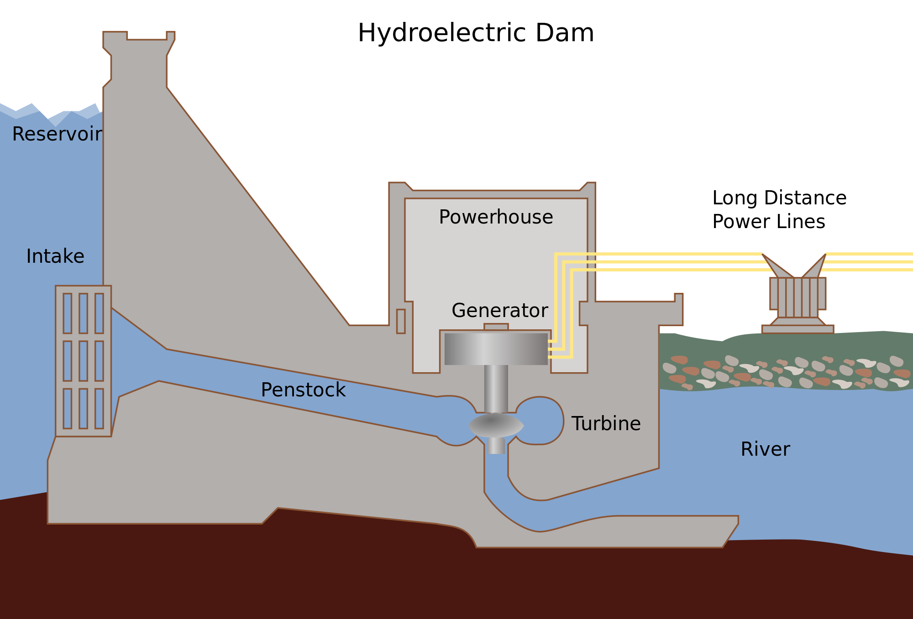
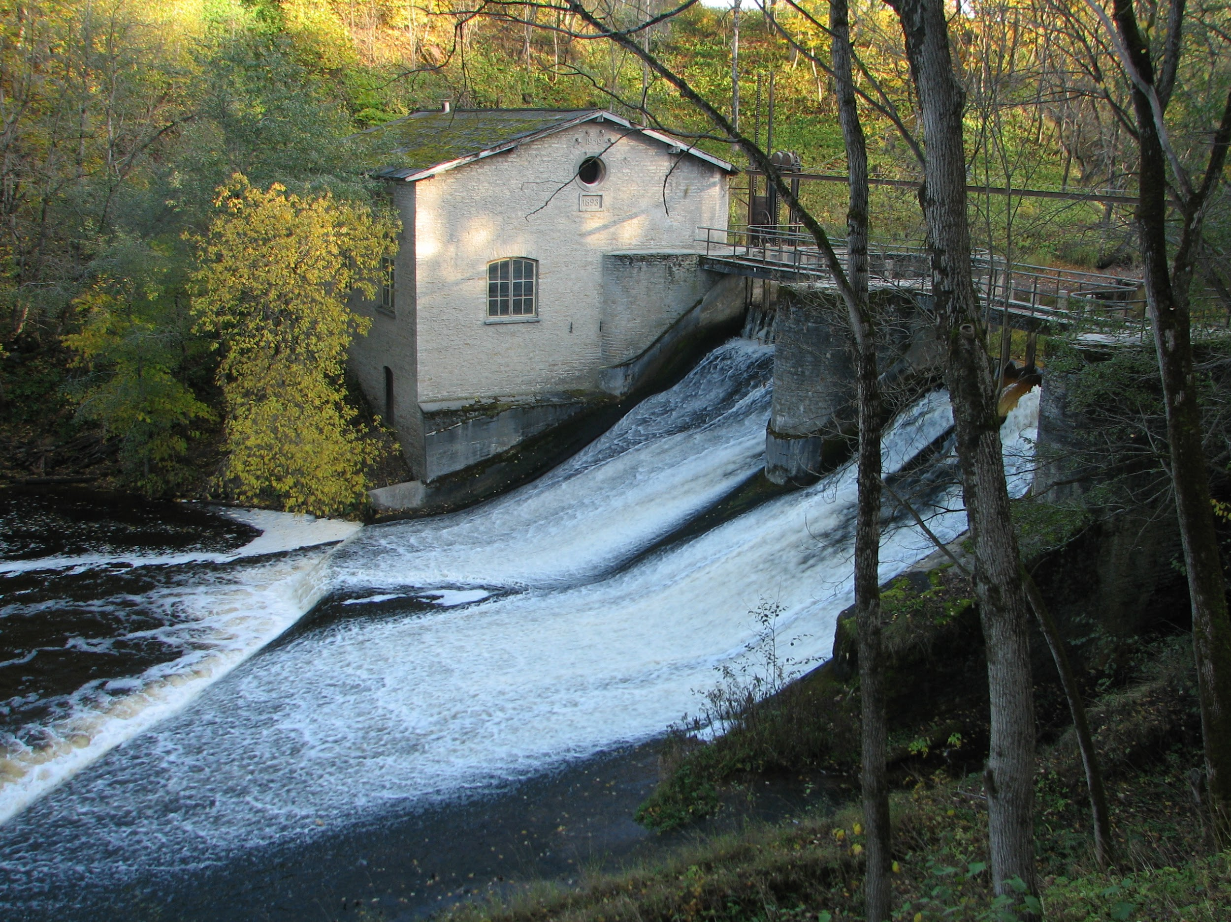
Hydroelectric Energy
Uses moving water to turn turbines that run generators.

Slide 5
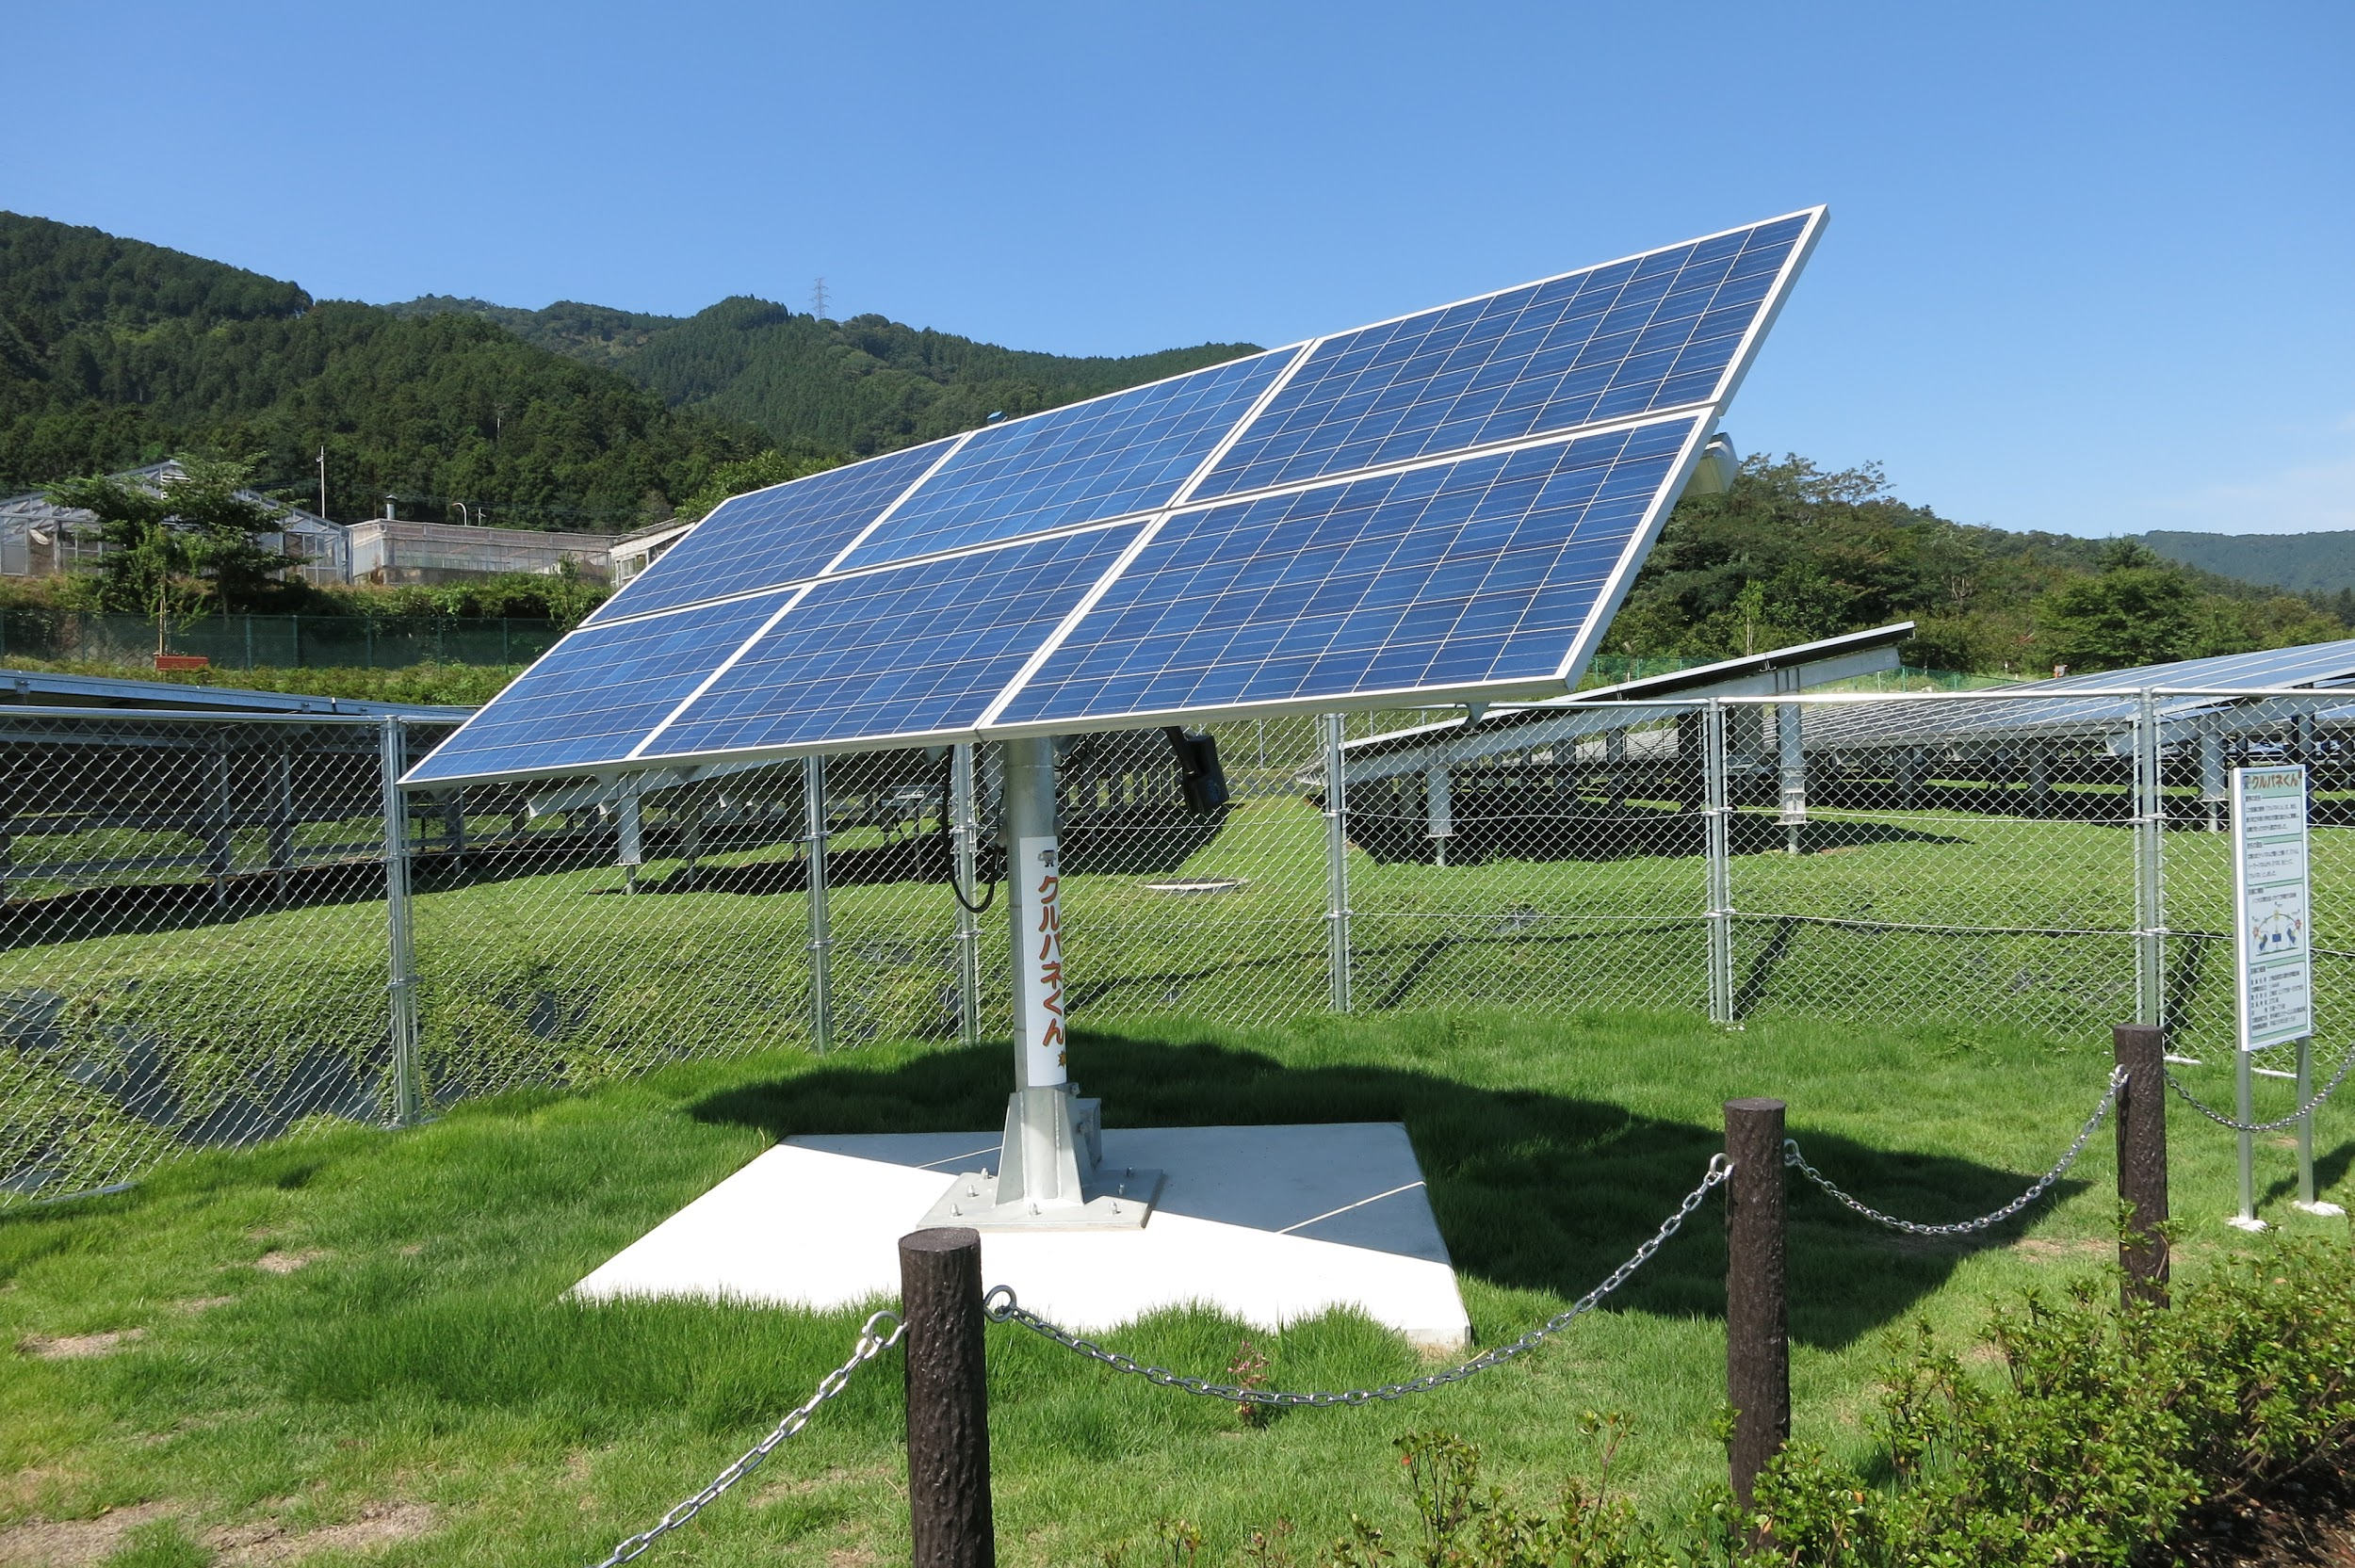
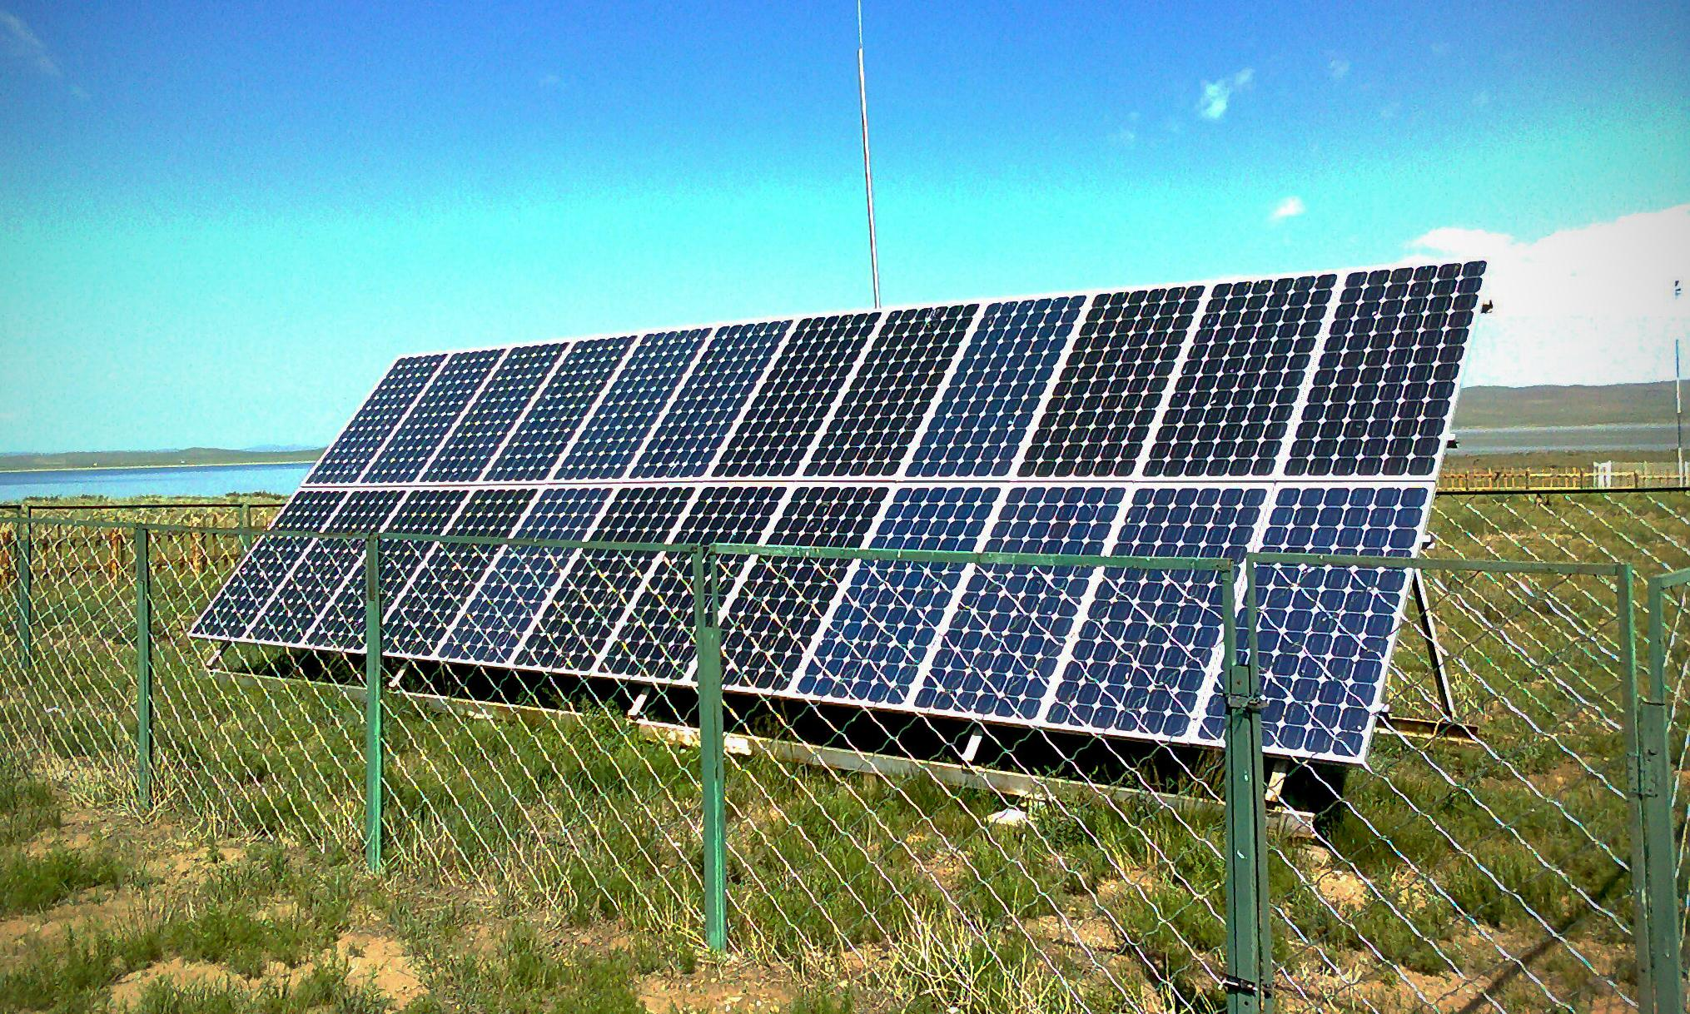
Solar Power
Harnessing the sun's energy to be converted into usable energy.

Slide 6
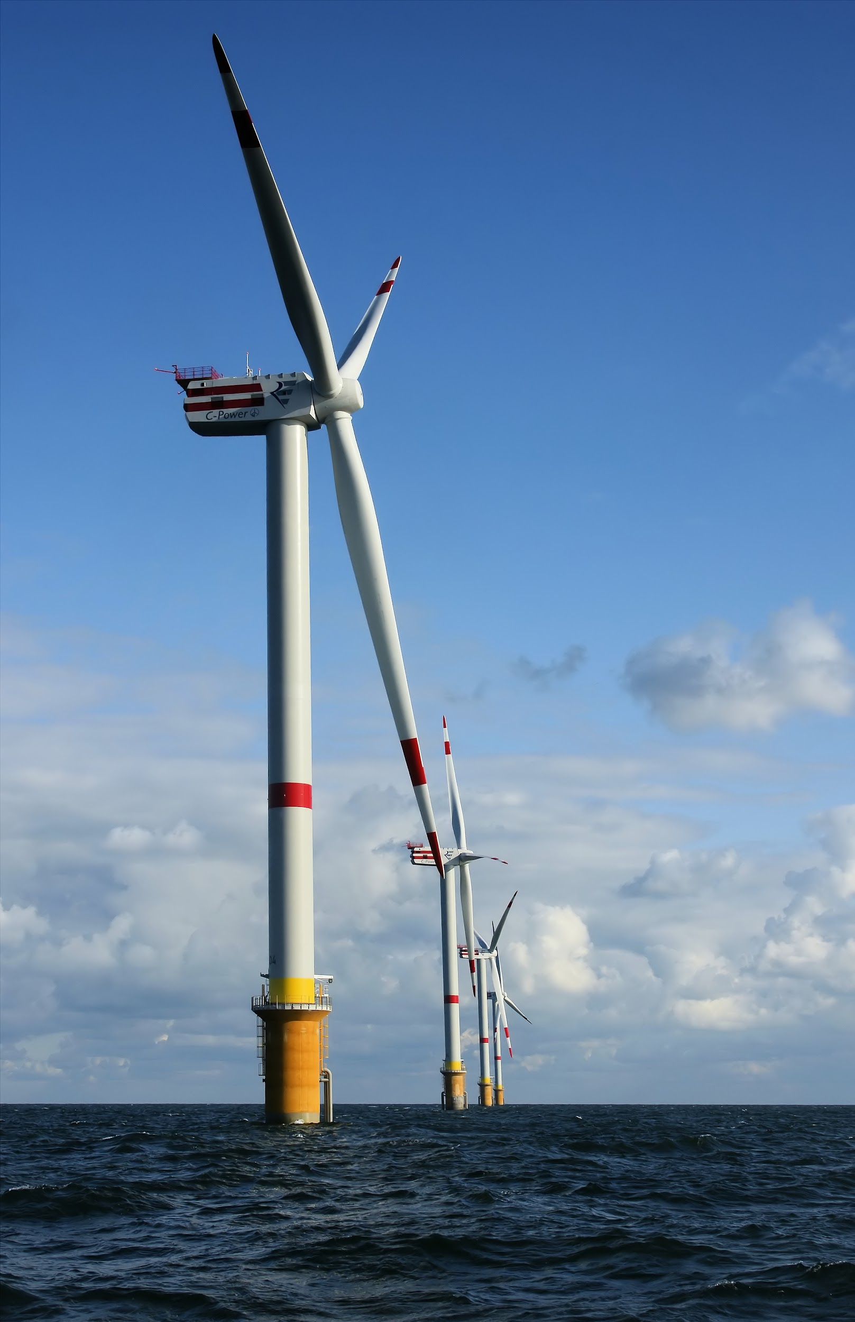
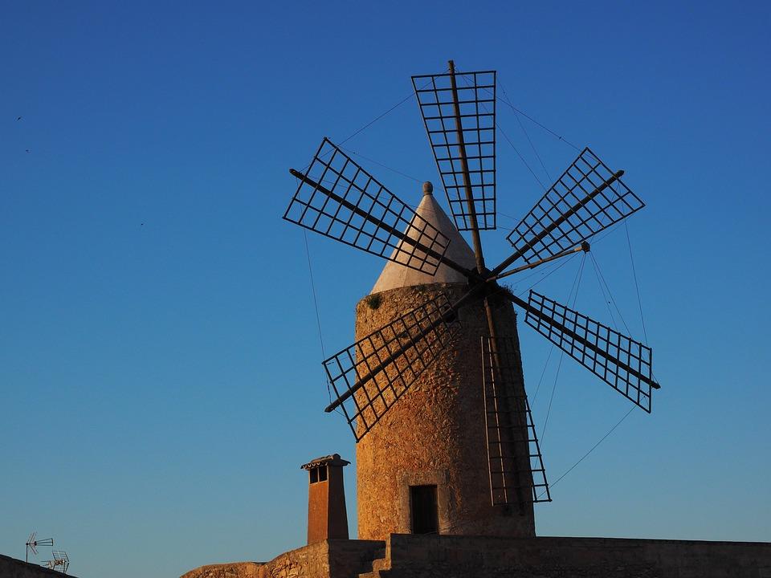
Wind Power
Wind turns turbines running generators.

Slide 7
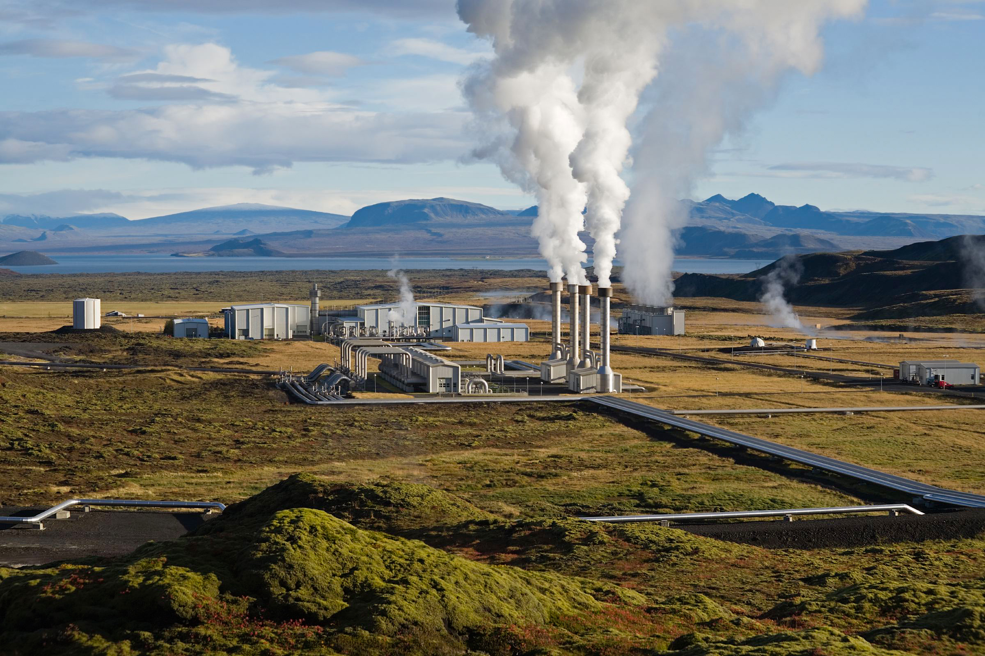
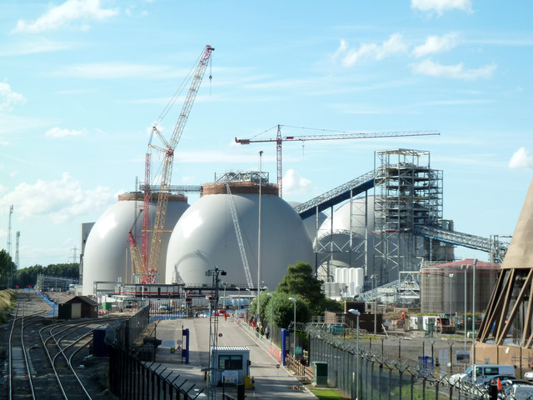
Biomass Power
Burning dead plants/animals much like fossil fuels.

Slide 8
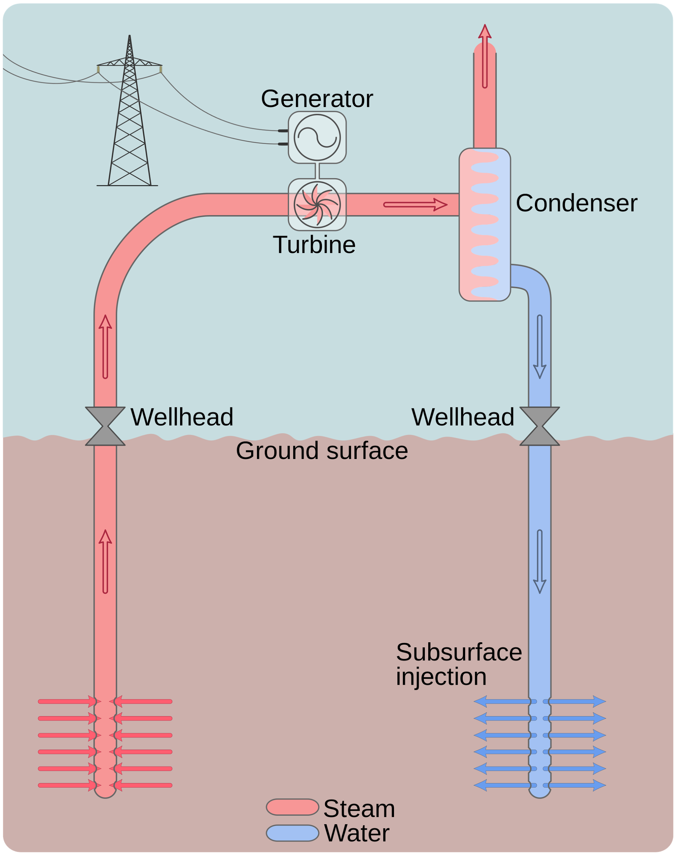
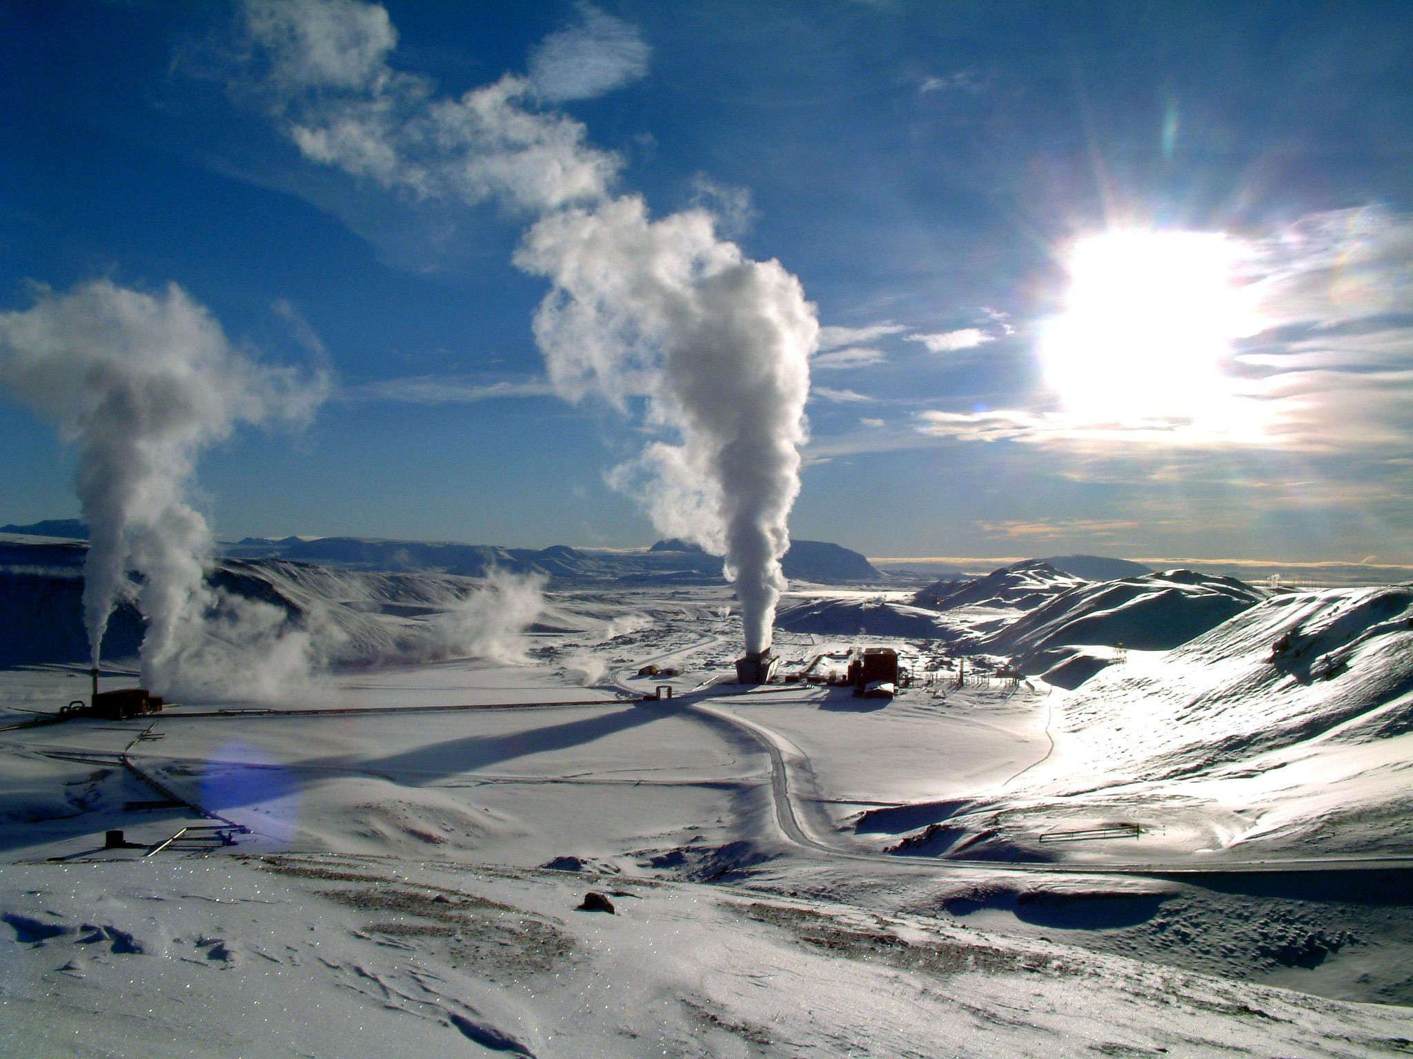
Geothermal Power
Using the heat of the earth to heat and cool a building or using the hearths heat to turn turbines.

Slide 9
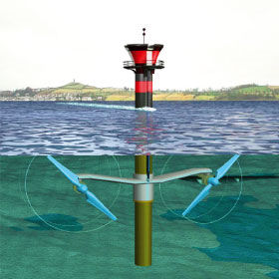
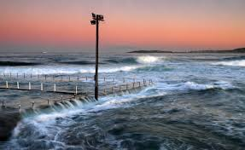
Tidal Power
Using the tides to turn turbines.

Slide 10
Wave Power
https://www.youtube.com/watch?v=rmub25aywYo

Slide 11
All of these power sources have flaws, some more than others. The best way to combat these flaws is to design a combination of the generators for specific locations. Such as a float system around an wind turbine in the ocean or solar panels and wind farms in the same area.

