Slide 1
Different Foods you Didn’t Know Were Harming the Environment
By: Cassidy Hoffman

Slide 2
The Truth
Although these foods are not harming the environment themselves, the work put into growing, harvesting, producing, and transporting these items has many harmful effects on our environment.

Slide 3
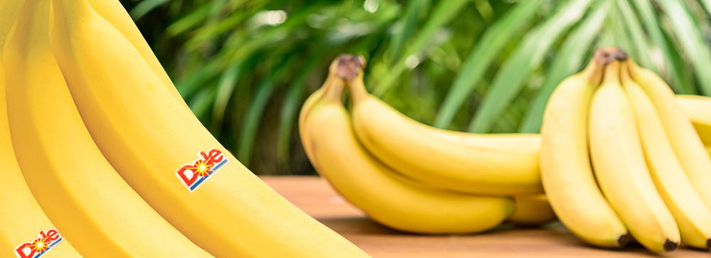
Bananas
Most of the world’s bananas all grow in Ecuador, Colombia, Costa Rica, Guatemala and Honduras. Which means bananas have to be flown to our stores, which releases massive amounts of CO2.
Also bananas are unnecessarily wrapped in plastic.

Slide 4
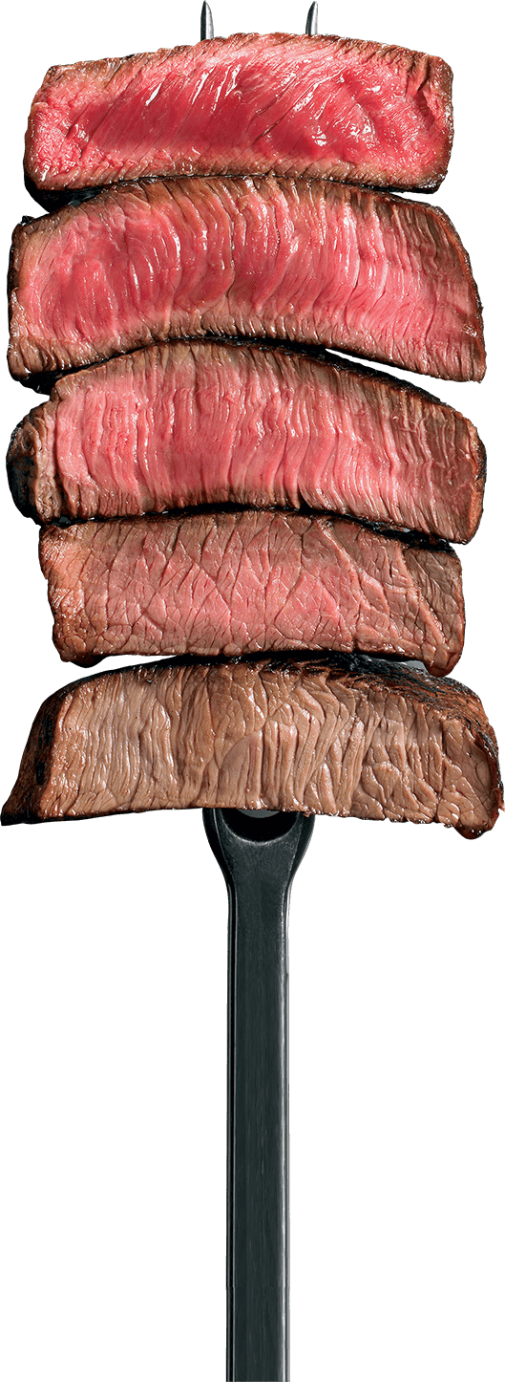
Beef
A cow releases between 70 and 120 kg of methane per year.
Methane is a greenhouse gas.
The negative effect it has on the climate is 23 times higher than the effect of CO2.
It would be more effective to cut down on beef then it would be to cut down on using cars.

Slide 5
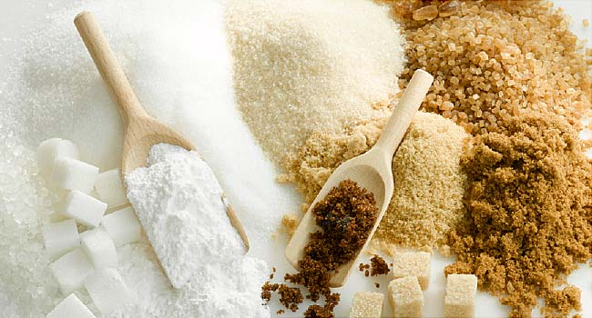
Sugar
Sugar mills produce water waist, and solid waste that harms the earth.
Large amounts of unused plant matter and sludge are often washed from mills to decompose in freshwater.
The waste absorbs all the available oxygen, resulting in massive fish fatalities.

Slide 6
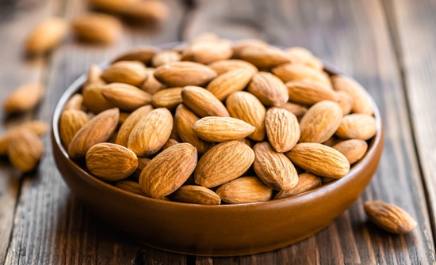
Almonds
Contributing to the California drought.
California is responsible for growing a whopping 80% of the world’s almond supply.
An average of 2 billion pounds a year.
1.1 gallons of water is used to produce a single almond.

Slide 7
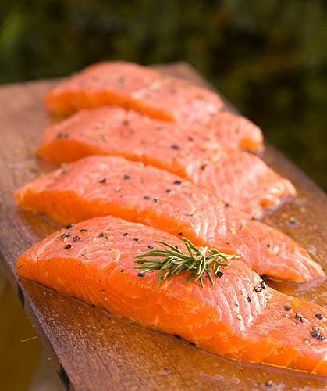
Salmon
Wild salmon is in danger of being overfished.
The industry began farm-raising salmon.
The technique uses open net-cages placed directly in the ocean, where farm waste, chemicals, disease and parasites are released directly into the surrounding waters.

Slide 8
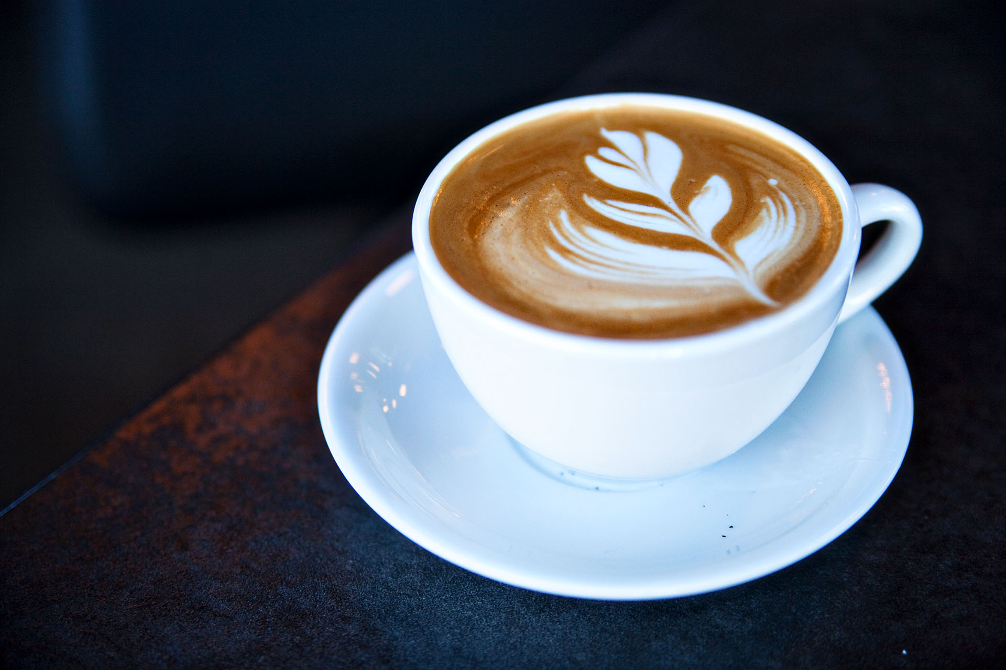
Coffee
Coffee is grown in the shade which helps prevent topsoil erosion and removes the need for additional chemical fertilizers.
Due to the increase in production a large share of the world’s coffee is now being grown in direct sunlight.
This requires chemical fertilizers and deforestation of land.

Slide 9
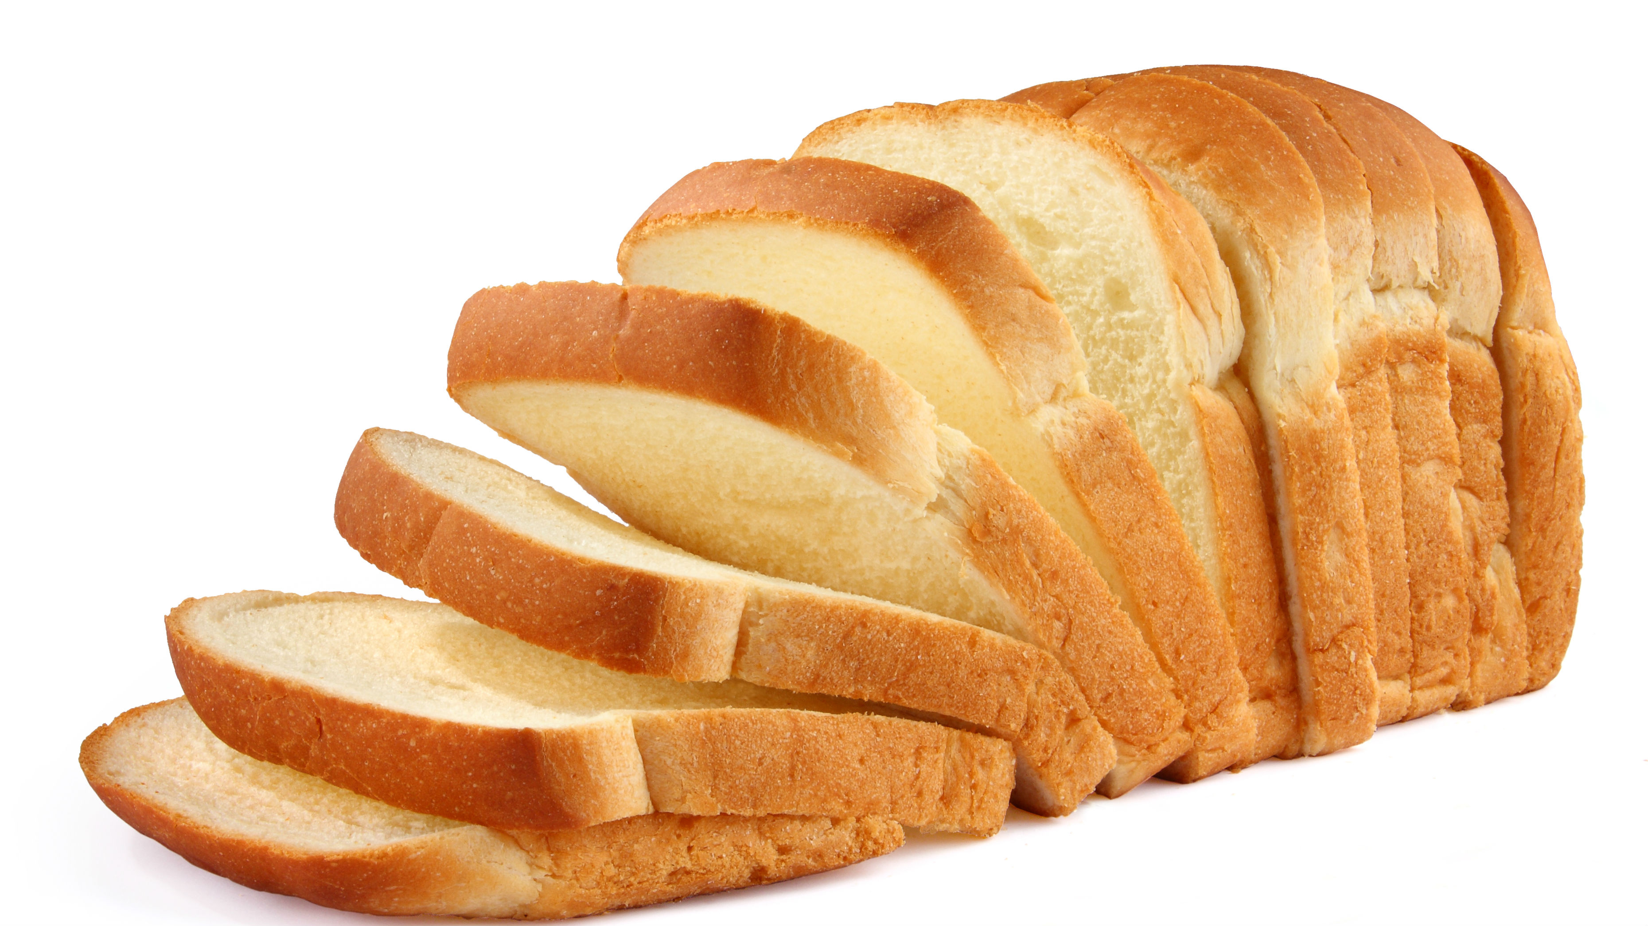
White Bread
Machine and human labor is required to produce the bread.
When an ingredient requires extensive refining, it also requires an increase in energy and resources leaving a greater impact on the planet

Slide 10
Conclusion
In the end all of these foods are harmful to the environment because they are no longer natural. Humans have modernized these items and these practices are what harm the environment.

Slide 11
Program Ideas
Front Desk Guessing

Slide 12
Work cited
“11 Foods You Didn't Know Were Hurting the Planet.” Brit + Co, www.brit.co/food-thats-bad-for-the-environment/.

