Slide 1
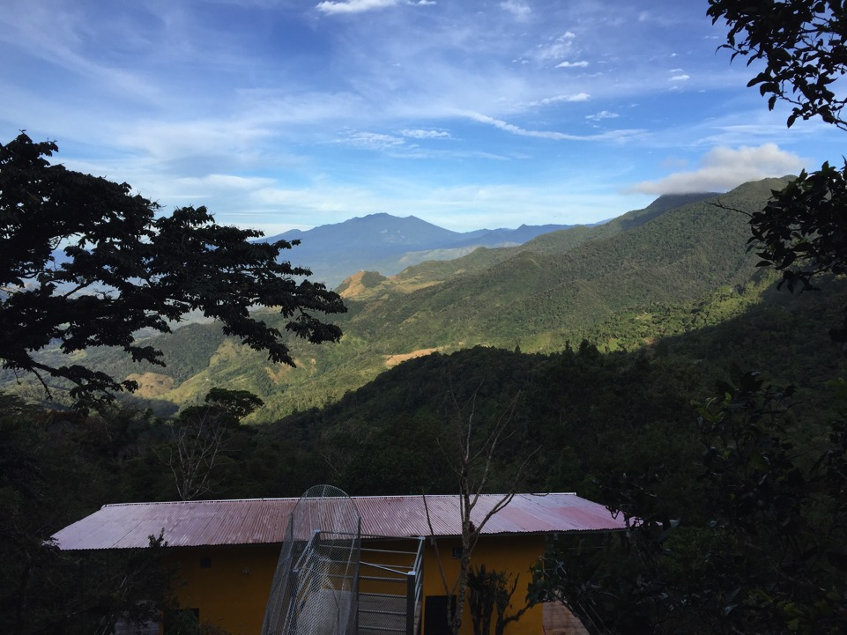
Eco-Lodges Around the World
By Catherine Werth

Slide 2
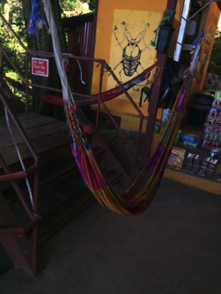
What is an Eco-lodge?
a type of tourist accommodation designed to have the least possible impact on the natural environment in which it is situated.

Slide 3
Why you should stay there?
Closer to nature
Not hurting environment as much
Meet people all over the world
Can be a cheaper way of traveling

Slide 4
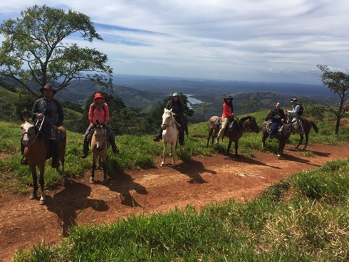
Lost and Found
Panama
Clouded Rainforests
Price
12 dollars a night
Activities
Horseback riding
Cliff jumping
Hiking

Slide 5
Mount Totumas
All power create on own, hikes, glass frogs, hummingbirds, professional birdwatchers

Slide 6
Inonesia:Misool Eco Resort
Snorkeling, scuba-diving, get a taste of culture

Slide 7
Australia:Great Ocean Ecolodge
Help care for injured wildlife, set out on 64 mile Great Ocean Walk

Slide 8
Program Ideas
Find where you want to travel and find and eco lodge and figure out cost and activities can do

