Slide 1
Protecting Native Songbird Populations
Cameron Kirkland

Slide 2
The Facts
The National Audubon Society estimates that 5 billion birds are killed a year. That means approximately 13.7 million die a day.
According to Nature Communications, 1.4-3.7 billion birds die because of cats every year.
Windows are thought to be the biggest threat to birds. Cats are the second.
Songbirds are necessary to the ecosystem for biodiversity and seed dispersal.

Slide 3
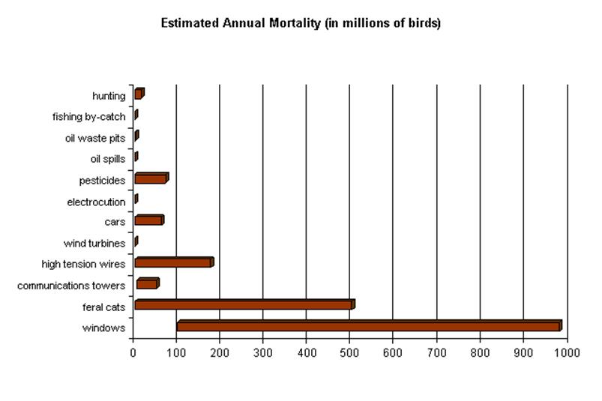
Bird Mortality Chart
Chart from sibleyguides.com

Slide 4
Program Ideas
Make bird door tags
Movie night (Angry Birds, Steward Little 2)
Create your own bird craft
Guess that bird call game
Bird shaped cookies

Slide 5
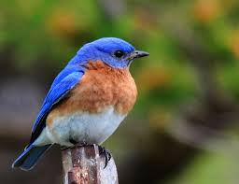
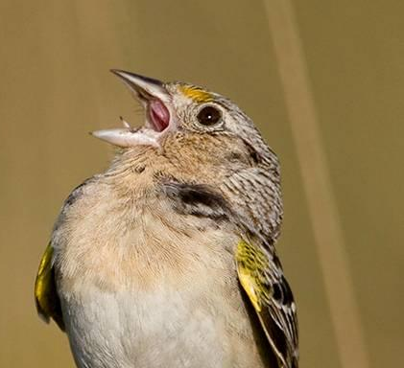
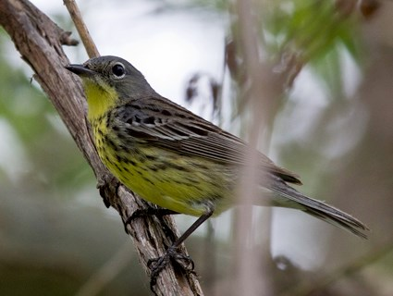
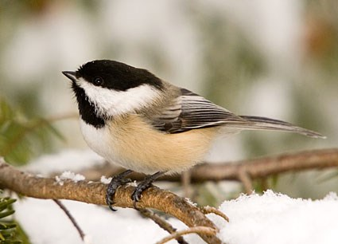
Songbirds Native to North America
Bluebirds
Florida grasshopper sparrow
Kirtland’s Warbler
Black-capped chickadee

