Slide 1
Effects of Manure
Bridget Stonemetz

Slide 2
Why is it important?
In the agricultural industry, a large amount of manure is produced each day. Every year farm animals produce about 335 million tons of manure.
If it is stored properly, the negative effects can be decreased.
If it is not handled correctly it can cause an environmental disaster.
Also, manure can be reused in many different ways.

Slide 3
Negative Effects of manure
Algae blooms which are due to high amounts of ammonia.
Salmonella.
E. Coli → groundwater pollution.
Excessive levels of nitrate, if combined with water, can cause illness in infants.
Pathogens.
Organic compounds in animal feed could lead to health risks.

Slide 4
Positive Manure Effects
Nitrogen is a great plant nutrient and fertilizer
Phosphorus acts as an enrichment material for plants.
Compounds found in manure can reduce soil erosion
Manure can also reduce the energy demands for gas invasive nitrogen fertilizers.

Slide 5
How to Properly Store Manure
Daily, put manure in a spreader and apply to crops.
Stock piling, keep away from water sources and feed sources. Eventually it will have to be picked up and hauled elsewhere.
* Keep in mind if water run off goes into the manure, make sure it is well drained and doesn’t go into crops or grass.
Avoid slopes and puddle areas for storing.
Stone dust is appropriate flooring and a tarp is a good idea to help maintain odor and rain damage.
Walls need to be a minimum of 4 feet high.

Slide 6
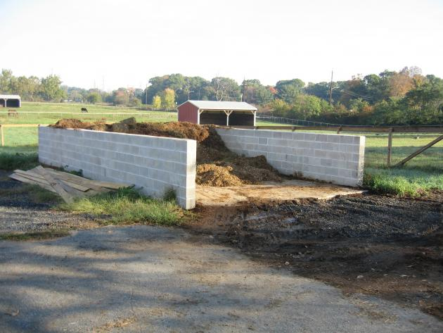
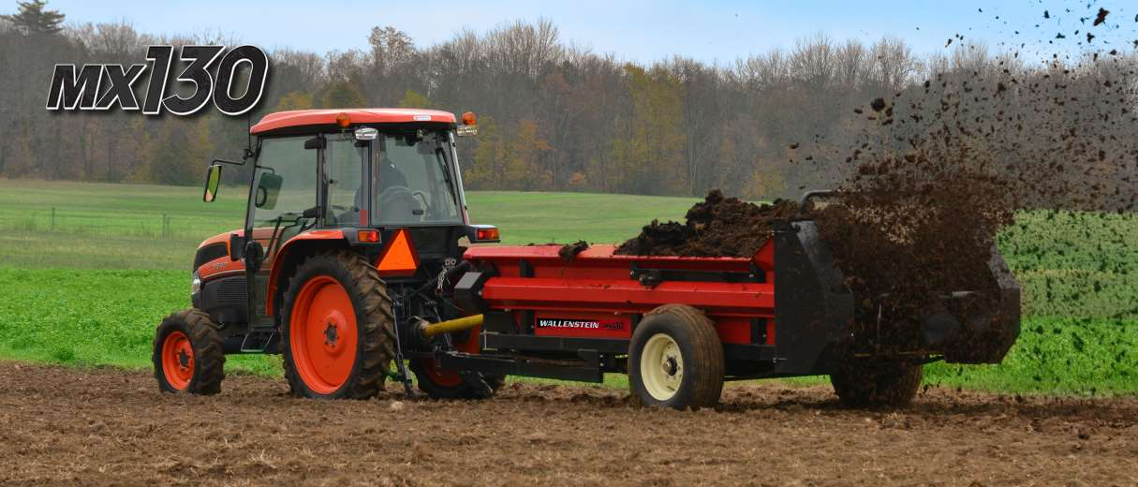

Slide 7
Ways to reuse manure!
In Thailand, they are starting to use manure to make paper out of the high fiber content!
Solid manure can be burned to produce energy! Chicken manure can produce electrical energy, cow manure can produce heating energy and pig manure can fuel cars!
Fertilizers: fresh manure has many different beneficial components but will contain a high nitrogen level and will be very heavy. Fresh fertilizer also requires less effort.
Composting: dry manure will have a low moisture content which will make it lighter. Though a lot of effort needs to go into composting manure. Although this will kill weeds and pathogens found in manure.

Slide 8
