Slide 1


Presented by Brian Smith
Director of Student Financial Services
SUNY Cobleskill
Notes:
Intro

Slide 2
2025-2026 Average Sticker Price
SUNY Schools:
In-State Tuition & Fees: $8,000 - $10,000
Room & Board: $12,000 - $15,000
Total (Sticker Price): $20,000 - $25,000
*also called 'Direct Costs'
Community College:​
In-State Tuition & Fees: $3,500 - $5,000​
Total (Sticker Price): $11,500 - $17,000
Private College:
Tuition & Fees: $40,000 - $60,000
Room & Board: $12,000 - $16,000
Total (Sticker Price): $52,000 - $76,000
Notes:
Title: 2025-2026 Average Sticker Price
Overview of direct costs (tuition, fees, room, board) for the upcoming year.
SUNY Schools: Tuition & Fees: $8,000 - $10,000
Room & Board: $12,000 - $15,000
Total (Sticker Price): $20,000 - $25,000
Community College: Tuition & Fees: $3,500 - $5,000
Total (Sticker Price): $11,500 - $17,000
(Room & board may vary if off-campus)
Private College: Tuition & Fees: $40,000 - $60,000
Room & Board: $12,000 - $16,000
Total (Sticker Price): $52,000 - $76,000
Key Points:"Sticker price" = direct costs before aid.
Many pay less with financial aid/scholarships.
Transition to aid options next.
Engage: Invite questions on lowering costs with aid resources.

Slide 3

Average Indirect Costs
Average Indirect Costs (2025-2026)
Books & Supplies: $1,200 - $1,500
Transportation (visiting home): $1,000 - $1,500
Miscellaneous Expenses: $2,000 - $2,500
Total Average Indirect Costs: $4,200 - $5,500
* Examples include parking permit, clothes, activity costs, personal items.
Notes:
Direct costs do NOT show up on a college bill, but colleges have to approximate them for you on the award letter.
Title: Average Indirect CostsOverview of additional student expenses not directly billed by colleges.
Categories:Books & Supplies: $1,200 - $1,500
Transportation (visiting home): $1,000 - $1,500
Miscellaneous Expenses: $2,000 - $2,500
Total Average Indirect Costs: $4,200 - $5,500
Key Points:Examples: Parking permits, clothes, activity costs, personal items.
These are estimates; costs vary by lifestyle and location.
Add to sticker price for total college cost.
Engage: Encourage questions on managing indirect costs with budgeting tips.

Slide 4

Notes:
State and federal grants are consistent whether you attend a private or public college. The SUNY Tuition credit is only available to SUNY students.
Net price is also referred to as net cost.
Title: Sticker Price vs. Net PriceExample comparing initial cost (sticker price) to actual cost (net price) after aid.
Private College:Sticker Price: $51,950
State & Federal Grants: -$7,000
College Scholarship: -$20,000
Net Price: $24,950
Accuracy: $51,950 aligns with 2025-26 private college averages ($52,000–$76,000). Grants ($7,000) and scholarships (~$20,000) are realistic for eligible students, yielding a plausible net price.
SUNY: Sticker Price: $23,350
State & Federal Grants: -$7,000
College Scholarship: -$3,000
Net Price: $13,350
Accuracy: $23,350 fits SUNY averages ($20,000–$25,000). Grants ($7,000) and scholarships ($3,000) reflect typical aid, with net price reasonable for in-state students.
Key Points: Net price = sticker price minus aid; varies by individual.
Emphasize aid’s role in reducing costs.
Transition to aid application process next.
Engage: Ask if attendees want help estimating their net price.

Slide 5
Financial Aid Applications
FINANCIAL AID APPLICATIONS
FAFSA (available October 1st)
NYS TAP (NY colleges only)
Excelsior (or enhanced tuition award at private colleges)
Some colleges require an additional scholarship application
Some colleges require the CSS profile
Notes:
NYS graduates attending NYS colleges are eligible to apply for TAP
Title: Financial Aid ApplicationsOverview of key applications for funding college.
Applications:FAFSA (available October 1st)
NYS TAP (NY colleges only)
Excelsior (or enhanced tuition award at private colleges)
Some colleges require an additional scholarship application
Some colleges require the CSS Profile
Key Points:FAFSA opens October 1, 2025; apply early.
TAP and Excelsior are NY-specific; check eligibility.
Additional apps may be required by certain schools.
Transition to deadlines and tips next.
Engage: Ask who’s planning to apply and offer assistance resources.

Slide 6

Free Application For Federal Student Aid

Slide 7
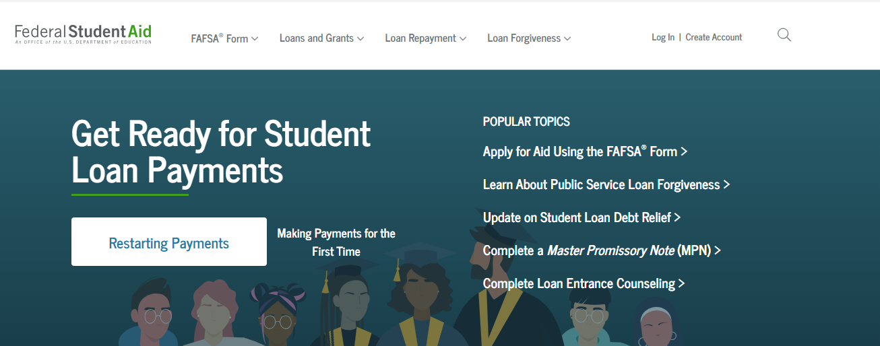
www.studentaid.gov
www.studentaid.gov or fafsa.gov
Notes:
Beware of fraudulent lookalike sites that expect payment. The FAFSA is FREE

Slide 8
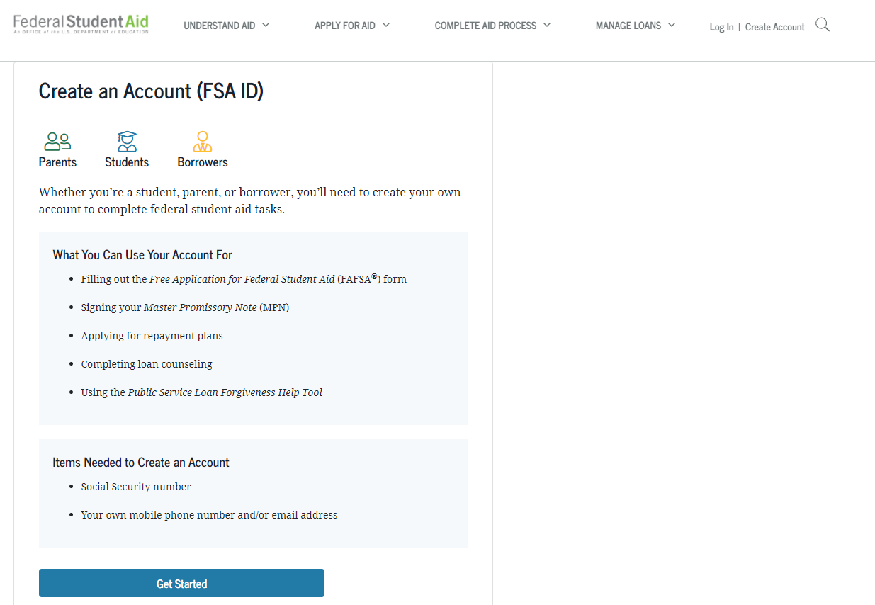
Both parent and student need their own FSA ID
What Do You Need
Name
Date of Birth
Social Security Number (?)
Mobile Phone Number
Email Address
Don’t use your high school email
Must be completed 3-5 business days prior to filling out FAFSA
Notes:
Both the student and parent need an FSA ID
Title: Create an Account (FSA ID)Essential step for federal aid processes.
Key Points:Both parent and student need their own FSA ID.
Required: Name, Date of Birth, Social Security Number, Mobile Phone Number, Email Address.
Don’t use high school email.
Must be completed 3-5 business days before FAFSA.
Uses: FAFSA, Master Promissory Note, loan counseling, repayment plans, Public Service Loan Forgiveness.
Action: Start at "Get Started" button.Engage: Ask who needs help creating an FSA ID; offer guidance.

Slide 9
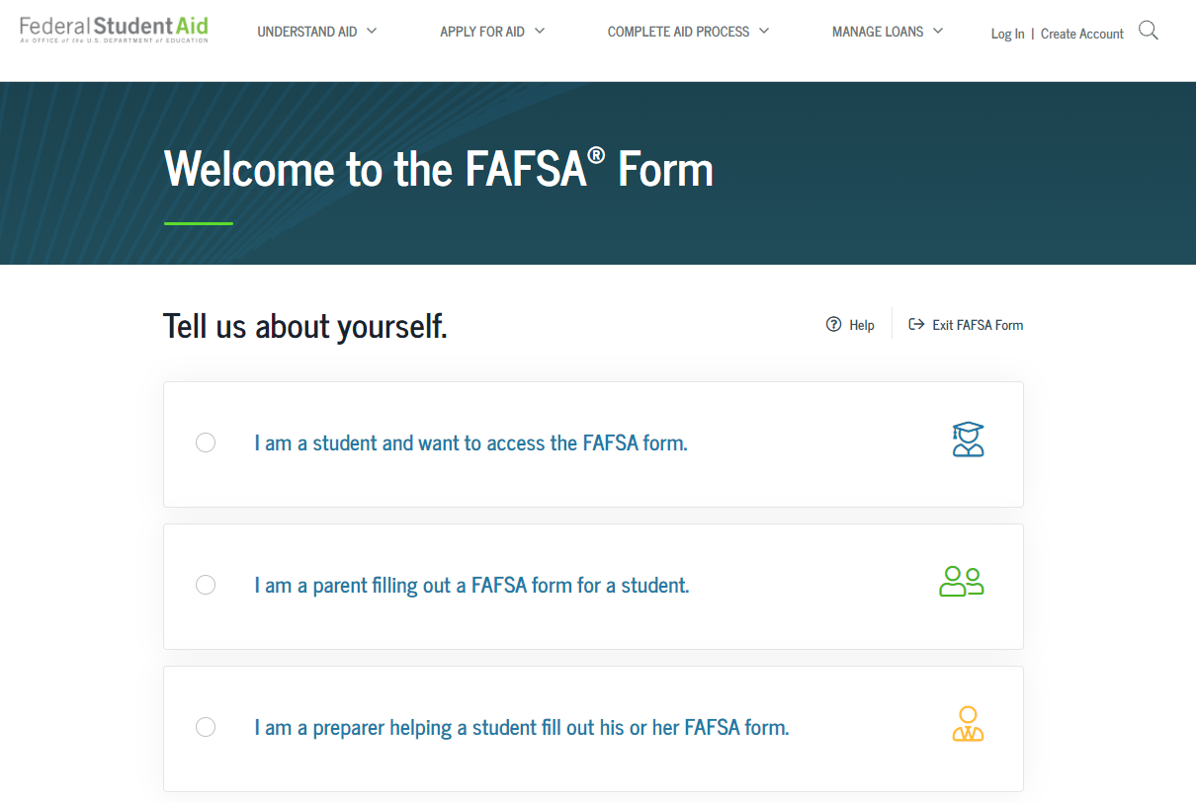
Notes:
Both the student and parent need an FSA ID

Slide 10


Tap.hesc.ny.gov/totw
Notes:
NYS Higher Education Services Corporation administers TAP, the STEM grant, Excelsior, etc; only available to NYS residents who attend NYS colleges.

Slide 11
FINANCIAL AID APPLICATIONS
Information used to calculate the Student Aid Index(SAI)
Measure of 2024 taxable and untaxable income and current assets of both student and parent
Also based on family size and other demographic info such as marital status
Colleges use the SAI to determine financial aid eligibility
For the 2026-2027 academic year, the FAFSA may be completed beginning
October 2025
Re-apply every year
The earlier you file, the earlier you may receive your aid offer and the more aid you may be offered
Most colleges set FAFSA filing priority dates
Notes:
NYS graduates attending NYS colleges are eligible to apply for TAP
Title: Financial Aid ApplicationsOverview of FAFSA and SAI details.
Key Points:SAI calculated using 2024 taxable/untaxable income, assets of student and parent, family size, and demographics (e.g., marital status).
Colleges use SAI to determine aid eligibility.
FAFSA opens October 2025 for 2026-2027 year.
Re-apply yearly; early filing boosts aid offers and timing.
Most colleges set FAFSA priority dates.
NYS graduates at NY colleges can apply for TAP.
Engage: Encourage early FAFSA filing; ask about priority dates at attendees’ schools.

Slide 12
Things to Look Out For
The number of questions on the FAFSA has decreased from over 100 to less than 50.
The EFC (Estimated Family Contribution) is now the Student Aid Index (SAI).
Students can list up to 20 schools on their FAFSA via the online application.
Applicants will be asked to report their sex, race, and ethnicity on the FAFSA itself, but students will be offered a choice of “Prefer Not to Answer”. Schools and states won’t see responses to these questions on the FAFSA.
The Data Retrieval Tool (DRT) has been renamed the Federal Taxpayer Information (FTI)
The Custodial Parent on your FAFSA will be the parent who provides you with the most financial support and will no longer be the parent with who you lived with the most over the past 12 months
Notes:
NYS graduates attending NYS colleges are eligible to apply for TAP

Slide 13
FINANCIAL AID APPLICATIONS
Students, spouses, parents, and stepparents will now need to provide their consent in the new Consent to Retrieve and Disclose Federal Tax Information section of the FAFSA for federal student aid eligibility.
This consent will allow the IRS to share FTI.
If any party to the FAFSA form does not provide consent, submission of the form will still be allowed. However, a Student Aid Index (SAI) will not be calculated.
Students and families will see a different measure of their ability to pay for college, and they will experience a change in the methodology used to determine aid.
The new need analysis formula:
removes the number of family members in college from the calculation
allows a minimum SAI of -$1,500
Implements separate eligibility determination criteria for Federal Pell Grant.
Child support received will be included in assets and not as untaxed income.
Families who own a small business/farm that also serves as primary residence will now have assets of that business/farm considered in their need analysis calculation.
Notes:
NYS graduates attending NYS colleges are eligible to apply for TAP
Title: Financial Aid Applications Updates on FAFSA consent and need analysis.
Key Points: Students, spouses, parents, stepparents must consent in FAFSA’s new Consent to Retrieve and Disclose Federal Tax Information section for SAI calculation.
If consent is missing, form submits, but SAI won’t be calculated.
New need analysis: Removes family members in college, sets minimum SAI of -$1,500, adds separate Pell Grant criteria, includes child support, and considers small business/farm assets.
Engage: Ask if attendees have questions about the new FAFSA process or consent requirements.

Slide 14
Who is the Parent on the FAFSA?
Biological or Adoptive Parent(s)
If not married BUT living together report BOTH parents
If parents are divorced:
Provide information for the parent who provided you the most financial support during the last 12 months
Include Step-parent information
Regardless of any ‘agreements’
Notes:
NYS graduates attending NYS colleges are eligible to apply for TAP
Title: Who is the Parent on the FAFSA? Defines which parents’ info is required.
Key Points: Include Biological or Adoptive Parent(s).
If unmarried but living together, report BOTH parents.
If divorced, report parent who provided most financial support in last 12 months.
Include Step-parent info, regardless of agreements.
Engage: Ask if attendees have questions about parent reporting; clarify with examples.

Slide 15
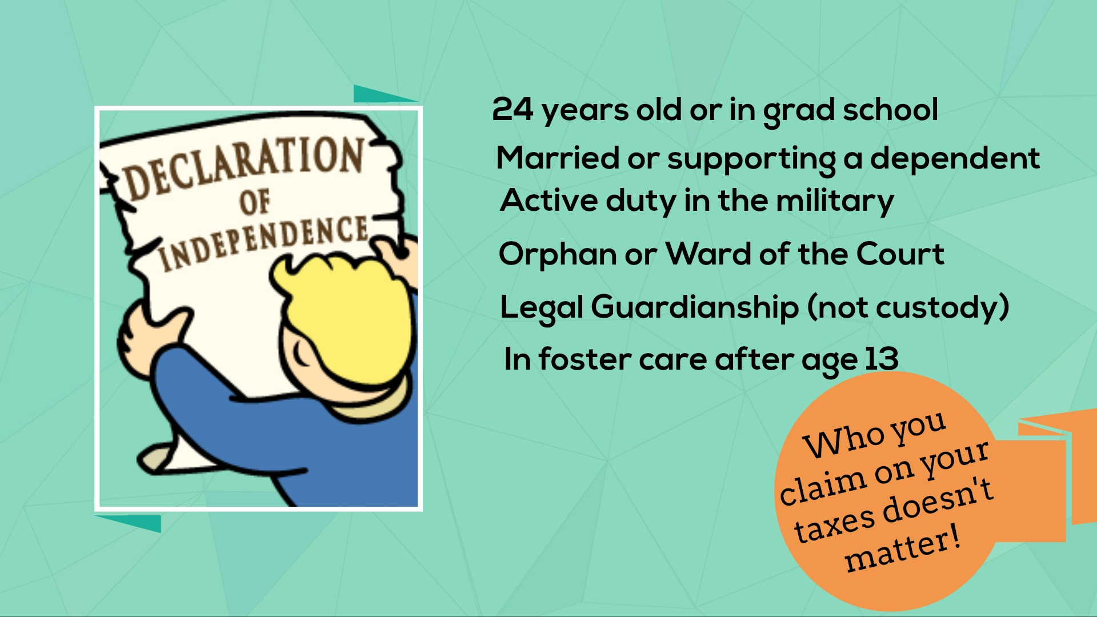

Notes:
Title: Verification Introduction to FAFSA verification process.
What Is Verification? A process where colleges or the Department of Education reviews FAFSA data for accuracy.
Ensures income, assets, and family info match IRS records or other documents.
Why Is It Required? Prevents fraud and ensures fair aid distribution.
Required if selected randomly or if discrepancies (e.g., mismatched income, incomplete data) are detected.
Causes of Verification: Random selection by federal processor.
Inconsistencies in FAFSA data (e.g., income vs. tax returns).
Estimated income or missing signatures.
Changes in household size or marital status.
Engage: Ask if anyone’s FAFSA was flagged; explain next steps (e.g., providing documents) if needed.

Slide 16
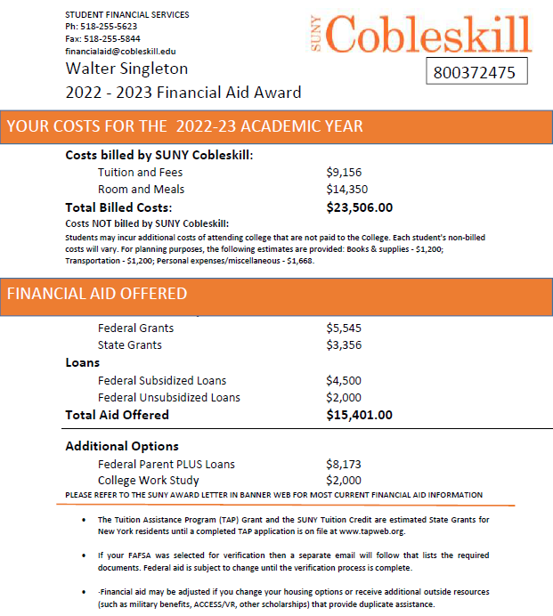
SAMPLE
AWARD LETTER
Notes:
Standard format used at most of the 64 SUNY campuses and community colleges.

Slide 17
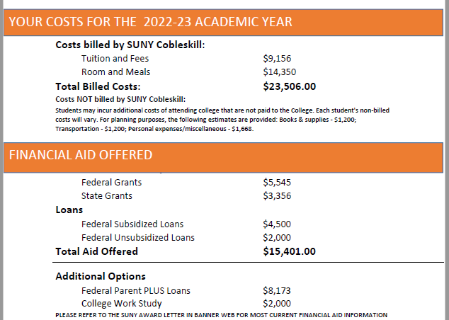
IN THIS EXAMPLE:
$8105 is NOT covered by the student’s financial aid
Notes:
The net cost or net price is the number that you should use to compare college costs (it excludes loans)

Slide 18
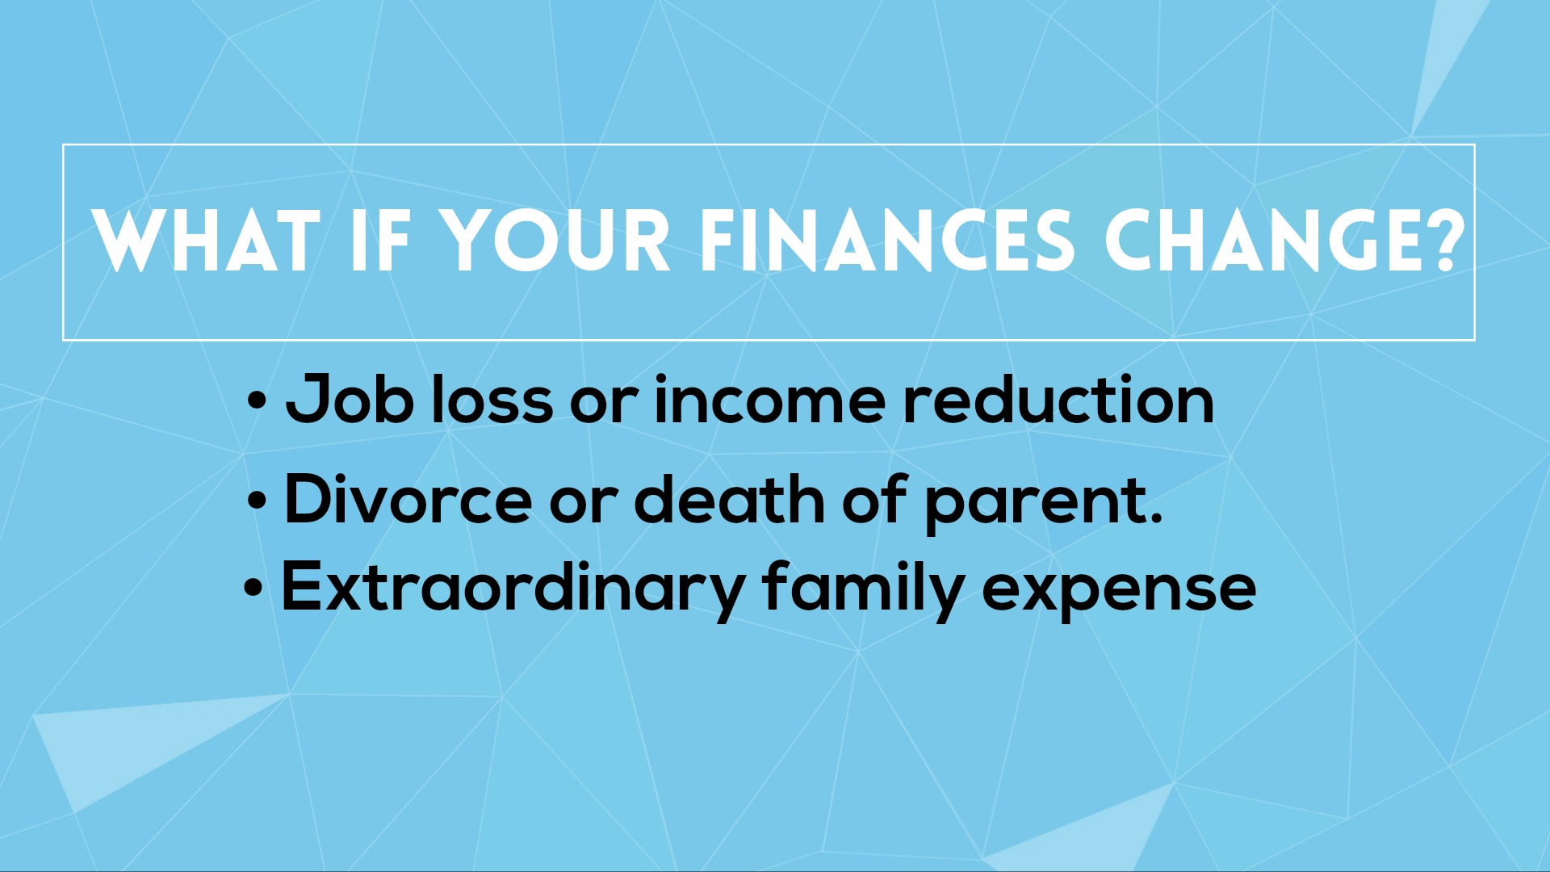
Notes:
Contact the financial aid offices of the colleges you are most likely to attend to discuss this.
Title: What If Your Finances Change?
Addresses financial changes affecting aid eligibility.
Key Scenarios:
Job loss or income reduction.
Divorce or death of parent.
Extraordinary family expense.
Professional Judgment (PJ) Process:
Allows colleges to adjust aid based on significant financial changes.
Requires submitting documentation (e.g., termination letter, medical bills, court documents) to financial aid office.
PJ can revise SAI or increase aid (e.g., Pell Grant, loans) if circumstances are verified.
Must be requested annually; decisions vary by school.
Engage: Ask if anyone experienced these changes; encourage contacting their aid office for PJ review.
Explain PJ documentation
FAFSA appeal process

Slide 19
WHAT IS THE EXCELSIOR SCHOLARSHIP?
Families earning $125k or less can attend a SUNY or CUNY tuition-free
Excelsior is a last dollar scholarship
If tuition is covered by grants and scholarships students would not benefit
Covers tuition balance after grants and scholarships
Notes:
Title: What Is the Excelsior Scholarship?
Overview of the NY tuition-free program.
Key Points:
Families earning $125k or less can attend SUNY or CUNY tuition-free.
Excelsior is a "last dollar" scholarship, covering remaining tuition after grants/scholarships.
If tuition is fully covered by other aid, students don’t benefit.
Covers tuition balance after grants and scholarships are applied.
Engage: Ask if attendees’ families qualify; encourage checking eligibility on ny.gov.
Explain eligibility details
Other state scholarships

Slide 20
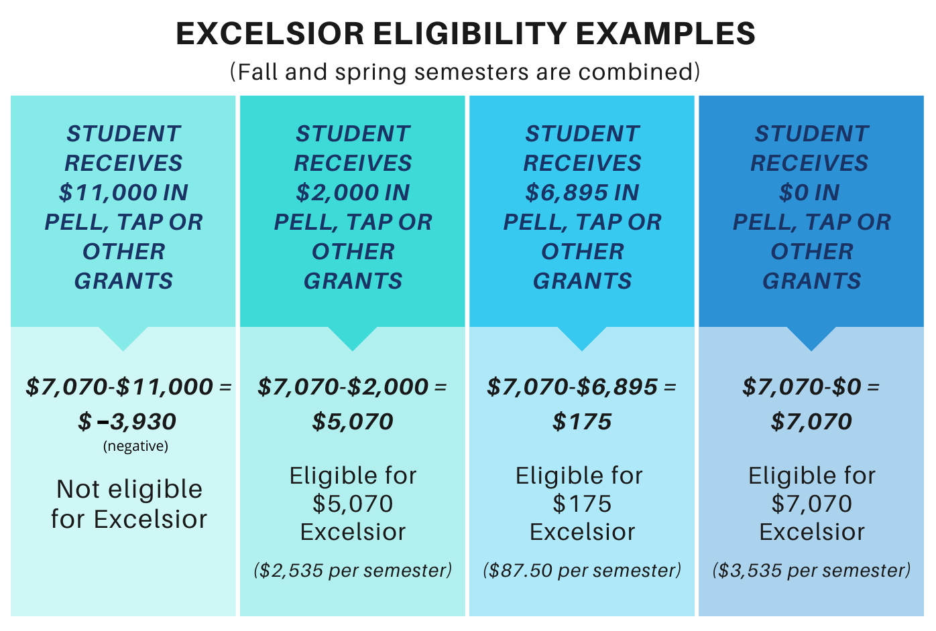
Notes:
Shows how aid affects Excelsior eligibility (fall and spring combined).
Examples: Student receives $11,000 in Pell, TAP, or other grants:
$7,070 (tuition) - $11,000 = -$3,930 (negative); Not eligible for Excelsior.
Student receives $2,000 in Pell, TAP, or other grants:
$7,070 - $2,000 = $5,070; Eligible for $5,070 Excelsior ($2,535/semester).
Student receives $6,895 in Pell, TAP, or other grants:
$7,070 - $6,895 = $175; Eligible for $175 Excelsior ($87.50/semester).
Student receives $0 in Pell, TAP, or other grants:
$7,070 - $0 = $7,070; Eligible for $7,070 Excelsior ($3,535/semester).
Key Points: Excelsior covers remaining tuition after other grants.
Negative balance disqualifies; full tuition gap qualifies.
Engage: Ask if attendees have questions about calculating their eligibility.

Slide 21
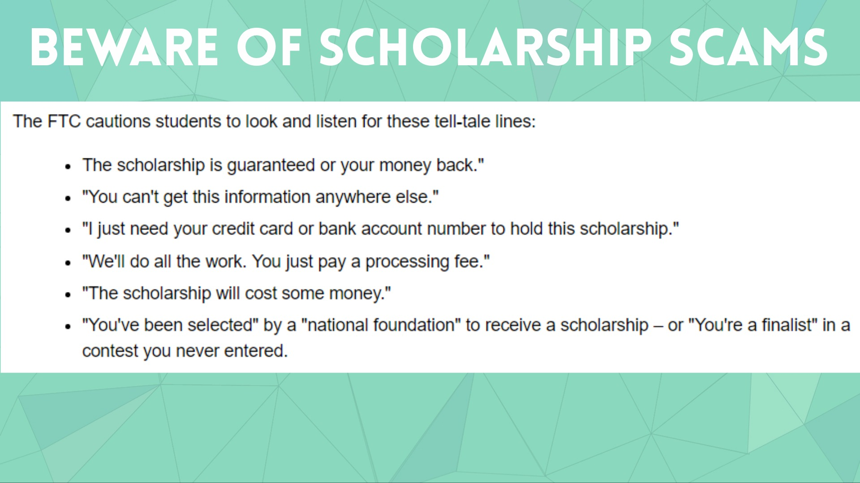
Notes:
Your guidance counselor and local community are the best resources for scholarships.
Title: Beware of Scholarship ScamsWarning about fraudulent scholarship offers.
Key Points:FTC advises watching for red flags:
"Guaranteed or money back."
"Can’t get this info elsewhere."

Slide 22
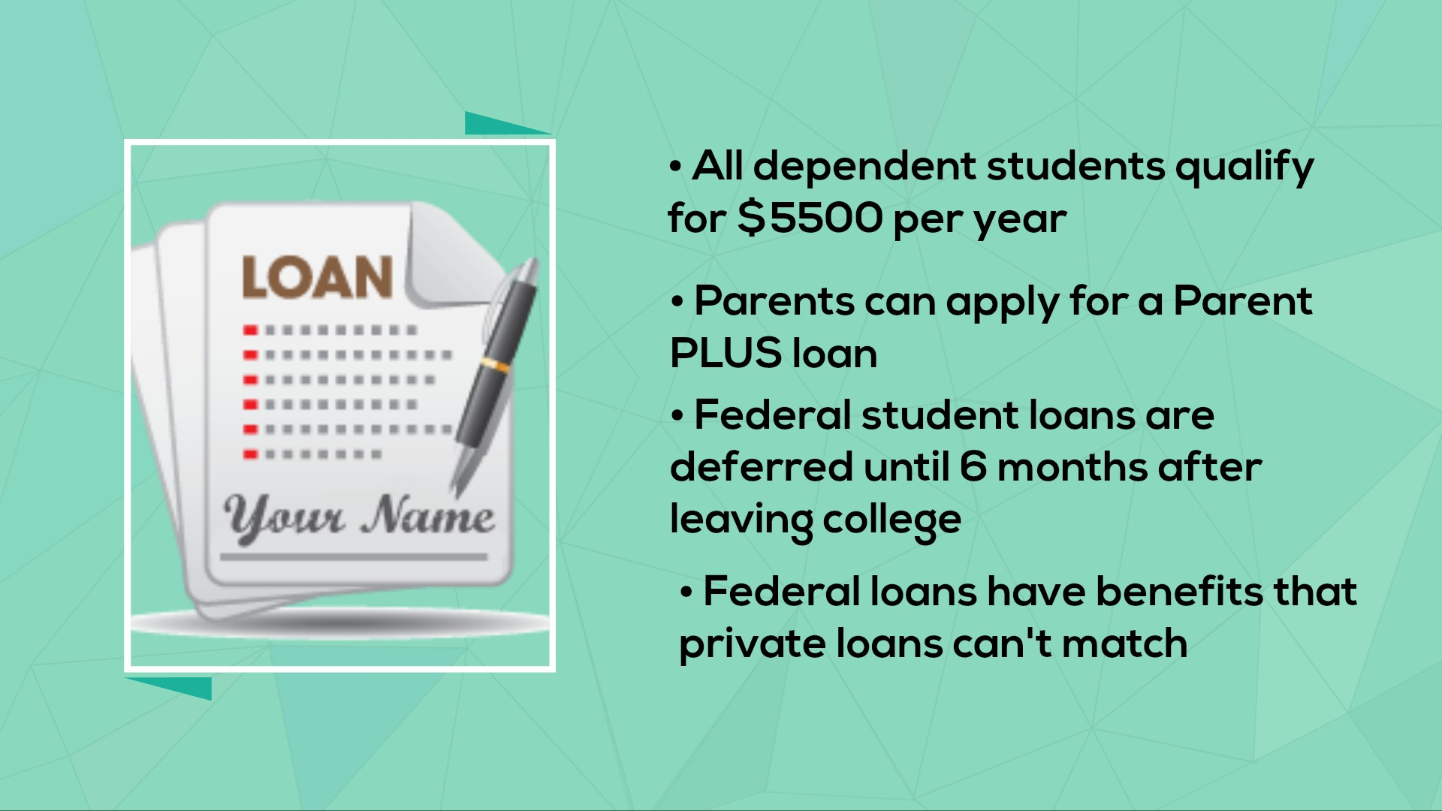
Notes:
Key Points:All dependent students qualify for $5,500 per year.
Parents can apply for a Parent PLUS loan.
Federal student loans are deferred until 6 months after leaving college.
Federal loans offer benefits (e.g., deferment, forgiveness) private loans can’t match.
Engage: Ask if attendees plan to use federal loans; highlight application via FAFSA.

Slide 23


Slide 24


Slide 25

Notes:
Up to $6000 per year is now available to Schoharie County HS graduates to put toward on-campus housing at SUNY Cobleskill.

Slide 26

SUNY Cobleskill Financial Aid Office:
518-255-5623
financialaid@Cobleskill.edu
Brian Smith (Director of Student Financial Services)
Joe Bisio (Financial Aid Advisor)

